Slide 1
Seminar
Lithium-Ion Batteries
AIRBUS, 31.07.2018.
Beispielzellen mitnehmen
Prof. Dr. Andreas Jossen andreas.jossen@tum.de
Dr. Peter Keil mail@peterkeil.de

Slide 2
Content
1. Lithium-Ion Cell Technology
Main advantages of lithium-ion batteries
2. Battery Systems
Parallel and serial interconnection of cells
Potential risks when using lithium-ion batteries
Energy and power characteristics
State-of-the-art battery materials
Components and working principle
Types of lithium-ion battery cells
Concepts for safe and reliable battery systems
Battery management system
Thermal management
Impact of temperature on battery performance
Inhomogeneities in battery systems
Safety concepts on cell level
Mechanical stress owing to cell deformation
4. Modelling and Simulation
Modelling strategies for different length scales
Electrical and thermal simulation
Parameterization & validation
3. Battery Aging
Degradation mechanisms
5. Development Trends
Next-generation Li-ion cells
New materials & technologies
Modern battery diagnostics
Calendar and cycle aging
Performance loss: capacity fade and resistance increase
Influencing factors
Accelerated aging tests

Slide 3
1 Lithium-Ion Cell Technology
1.1 Main advantages of lithium-ion batteries
1.2 Components and working principle of lithium-ion battery cells
1.3 Types of lithium-Ion cells and their advantages / disadvantages
1.4 State-of-the-art lithium-ion battery materials
1.5 Energy and power characteristics resulting from cell design
1.6 Potential risks when using lithium-ion batteries
1.7 Safety concepts on cell level

Slide 4



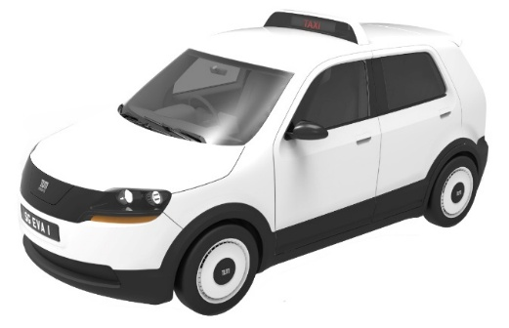


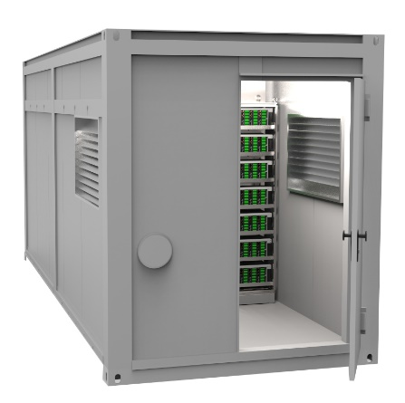
1.0 Typical applications of lithium-ion batteries
Initial fields of application
New fields of application
Cell Phones
Portable
Computers
Electric Planes
4 Cs
Mobility Solutions
Stationary Storage Systems
Electric Cars
Consumer
Electronics
Cordless Tools
Containers for
Grid Storage
Notes:
eigene Fotos

Slide 5
1.1 Main advantages of lithium-ion batteries
Basic principle of a rechargeable battery
Quality criteria
  High storage capacity for electrical energy
  Low weight
  Small volume
  Fast chargeable and dischargeable
  Low losses during charging and discharging
  Low self-discharge rate
  Long battery life
Charging
Electrical Energy
Chemical Energy
Discharging

Slide 6
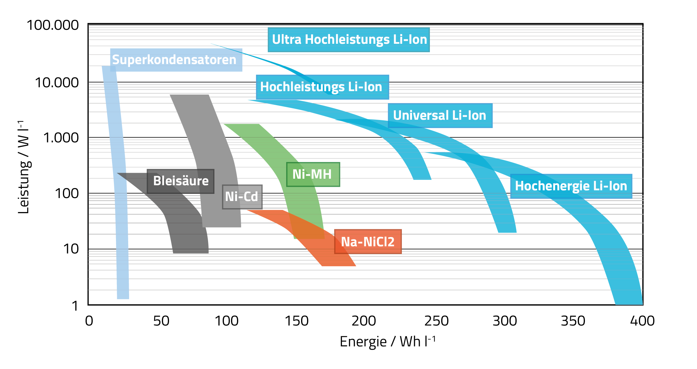
1.1 Main advantages of lithium-ion batteries
superior performance indicators:
energy density (Wh/l), specific energy (Wh/kg), power density (W/l), and specific power (W/kg)
Lithium is the most electro-negative material in the electrochemical series -> high potential
Lithium is the solid material with the lowest density -> low weight
Further advantages:
  No side reactions
  High efficiency
  No memory effect
  Long cycle life
[JOU]

Slide 7
1.1 Main advantages of lithium-ion batteries
Comparison with different battery technologies
Disadvantages of lithium-ion batteries
  Higher cost owing to expensive materials and complex manufacturing processes
  Additional efforts for maintaining safe operation
  Reduced performance at low temperatures
 | Pb | NiCd | NiMH | Li-Ion
Nominal Voltage U_{N} | 2.0 V | 1.2 V | 1.2 V | 3.6-3.7 V
Specific Energy (Wh/kg) | 20-40 | 30-60 | 60-100 | 80-250
Energy Density (Wh/l) | 60-110 | 90-180 | 200-370 | 160-670
Max. Discharge Rate (C) | 0.5-2 | 1-10 | 1-10 | 1-30
Self-discharge (% per month) | 5-10 | 10 | 15-25 | <1
Battery Life (cycles) | 150-400 | 300-800 | 300-800 | 500-5000
[MÄH]
Notes:
Battery University - Schulungsunterlagen
verglichen auch mit Linden Handbook of Batteries 3rd edition

Slide 8
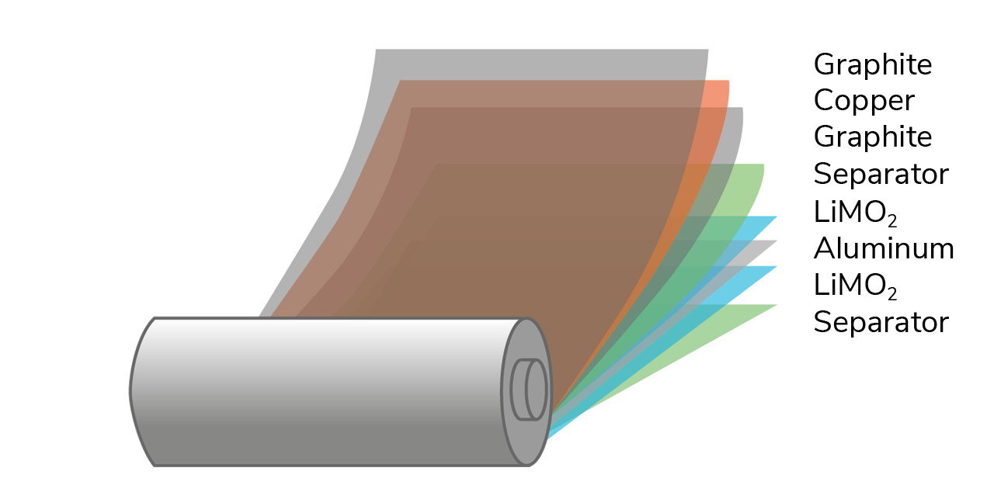
1.2 Components and working principle of a lithium-ion battery cell
Cell components:
Negative electrode (anode)
  Porous active material, mostly graphite
Positive electrode (cathode)
  Porous active material, lithium metal oxide, e.g. LiCoO₂
Electrolyte
  Organic solvents with dissolved lithium ions
  Typical solvents: cyclic and linear carbonates
  Conducting salt: usually LiPF₆
Current collectors
  Anode: copper foil
  Cathode: aluminum foil
Separator
  Porous polymer foil
Current
Collector
Anode
Current
Collector
Cathode
–
+
Anode
Separator
Cathode
–
+
[VDE],[TAR]
Notes:
evtl. noch Schichtdicken

Slide 9
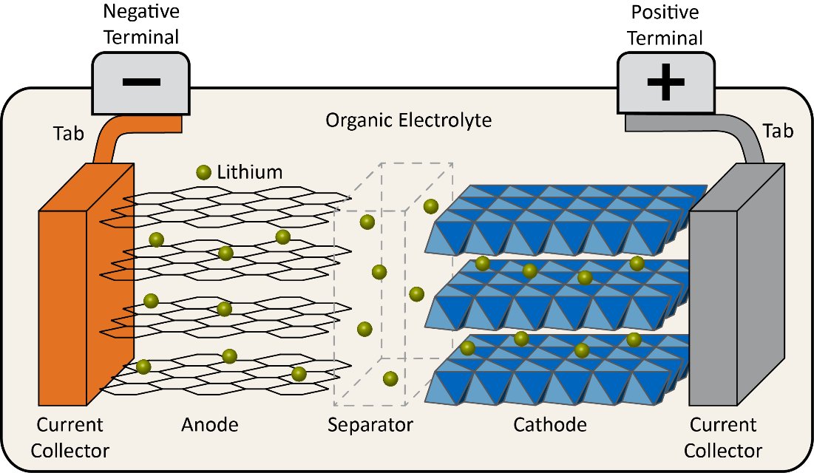
1.2 Components and working principle of a lithium-ion battery cell
Working principle
Reaction equations
Positive electrode: LiCoO₂ Li_{1-x}CoO₂ + x Li⁺ + x e⁻
Negative electrode: x Li⁺ + x e⁻ + C₆ Li_{x}C₆
Overall reaction: LiCoO₂ + C₆ Li_{1-x}CoO₂ + Li_{x}C₆
Charging process
  Withdrawal (deintercalation) of lithium ions from cathode active material (positive electrode)
  Simultaneous storage (intercalation) of lithium ions into anode active material (negative electrode)
  Equalization of different lithium-ion concentrations in the electrolyte by diffusion of lithium-ions from cathode to anode
  Rising energy content and cell potential
Discharging process
  Reversion of all processes
Specific feature of lithium-ion batteries:
  Intercalation electrodes instead of conversion electrodes
  No dissolution and deposition of active materials during charging and discharging (as it is the case for e.g. lead-acid batteries)
  Active materials of both electrodes serve solely as host lattice structure for the insertion and extraction of lithium-ions
  The structural composition of the electrode active materials remains unchanged during charging and discharging
Charging
Discharging
Charging
Discharging

Slide 10
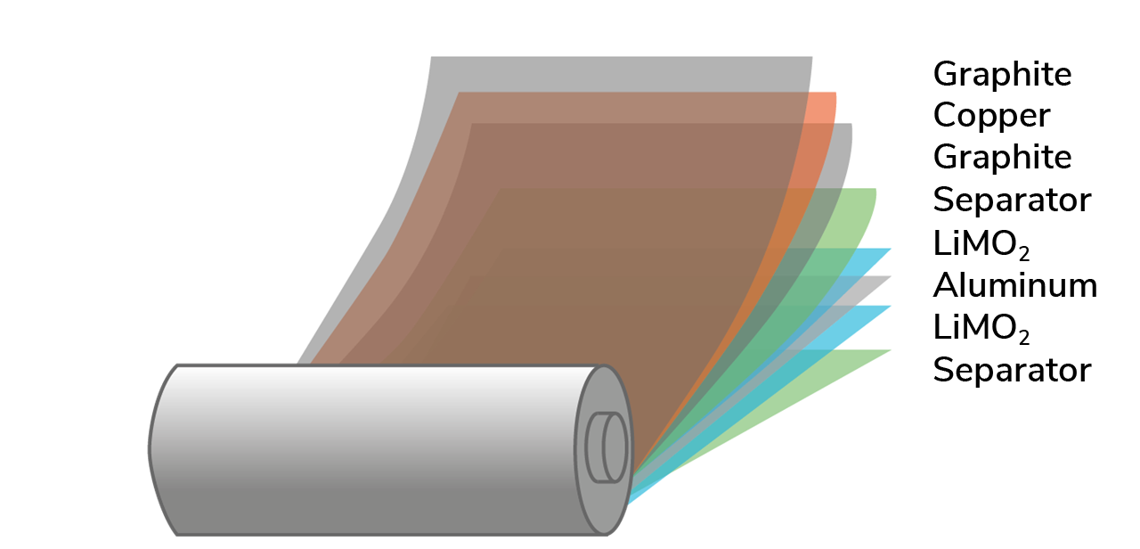
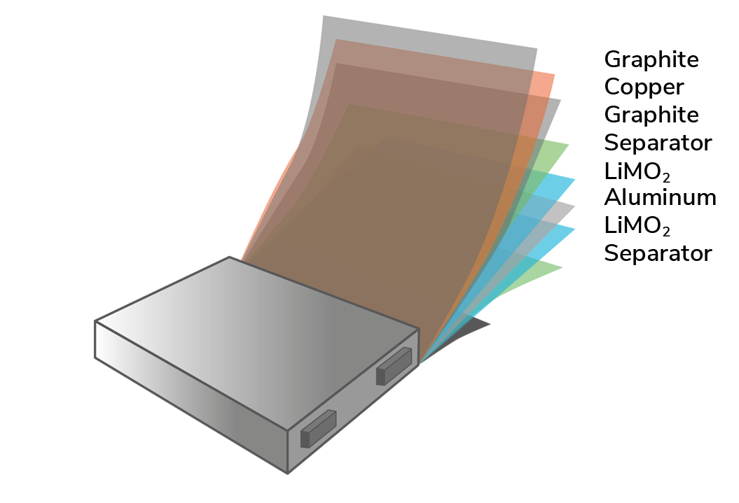
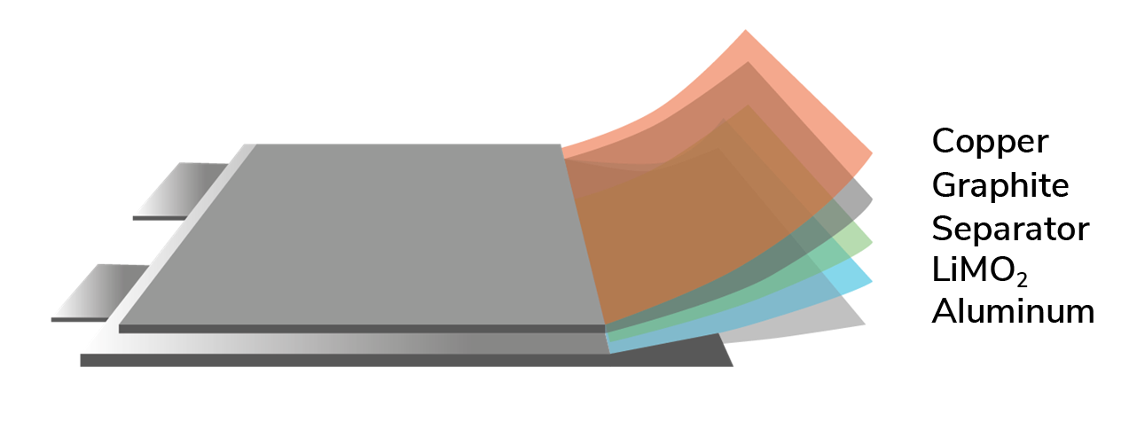
1.3 Types of lithium-Ion cells and their advantages / disadvantages
 | Cylindrical Cells | Prismatic Cells | Pouch Cells
Internal Structure | Cylindrical jelly roll in metal cylinder Liquid electrolyte | One or more elliptical jelly rolls in metal case Liquid electrolyte | Stacked or folded electrodes, sealed in aluminum-enforced polymer foils Polymer electrolyte, holds electrode layers together
[VDE],[TAR]
Notes:
Tarascon Nature-Paper
Möller Kompendium Li-Ionen-Batterien

Slide 11
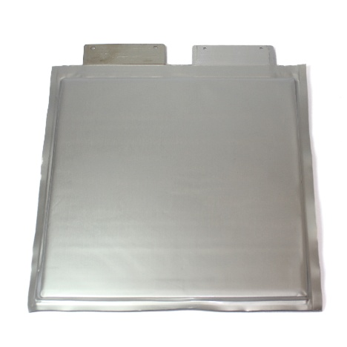
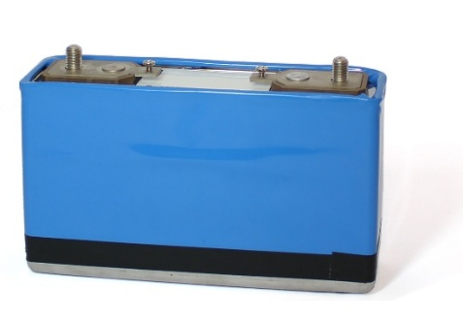
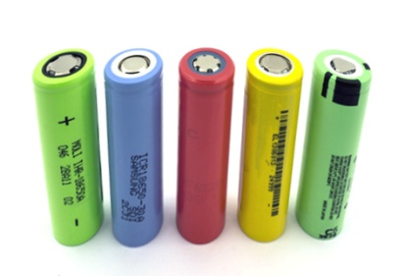
1.3 Types of lithium-Ion cells and their advantages / disadvantages
 | Cylindrical Cells | Prismatic Cells | Pouch Cells
Examples
Advantages | + Simple manufacturing + Stable cell housing + Standardized cell sizes (18650: ø18 mm, length 65 mm 26650: ø26 mm, length 65 mm) | + Prismatic shape facilitates module design + Standardized cell sizes for automotive cells (PHEV, BEV) | + Lower weight on cell level + Very thin cells fabricable + Most uniform mechanical strain for electrodes
Disadvantages | − Mechanical strain in active material during cycling, particularly in large cells | − Reduced volume utilization in the corner and edge regions lowers energy density | − Complex production processes − More extensive module design as cells provide reduced inherent stability
Notes:
eigene Fotos

Slide 12
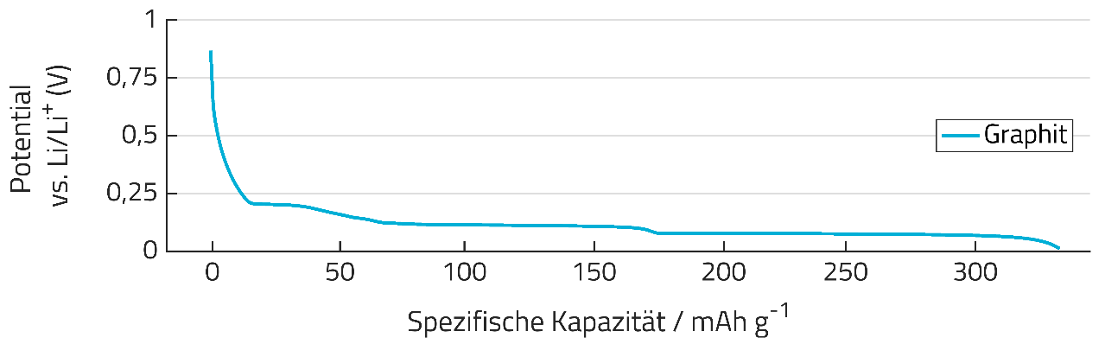
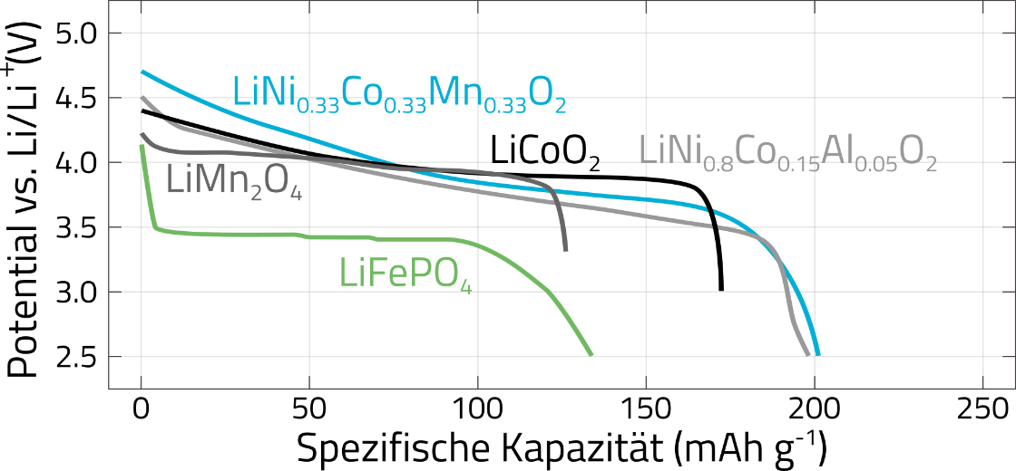
1.4 State-of-the-art lithium-ion battery materials
Voltage Curve of Graphite Anode
Criteria for electrode material selection
  High specific capacities
  Large potential difference between both electrodes
  Large active surface area for high current rates
  Long-term stability
Graphite (C₆) is the standard anode material for lithium-ion batteries
Various cathode materials are used in state-of-the-art lithium-ion batteries
  Lithium cobalt oxide (LCO)
  Lithium manganese spinel (LMO)
  Lithium nickel cobalt aluminum oxide (NCA)
  Lithium nickel manganese cobalt oxide (NMC)
  Lithium iron phosphate (LFP)
Typical operating voltage range: 2.7 – 4.2 V
Specific Capacity (mAh/g)
Voltage Curves of Various Cathode Materials
Specific Capacity (mAh/g)
[NIT]
Notes:
N. Nitta, F. Wu, J.T. Lee, G. Yushin, Li-ion battery materials: Present and future, Materials Today 18 (5) (2015) 252–264.

Slide 13
1.4 State-of-the-art lithium-ion battery materials
Comparison chart
Mobility applications: NMC and NCA cell types because of higher energy density
Stationary battery systems: often also LFP cell types because of their longer cycle life
High peak power applications: LFP and LMO cell types
 | LCO | LMO | NMC | NCA | LFP
Nominal Voltage U_{N} (V) | 3,7 | 3,7 | 3,6 | 3,6 | 3,3
Specific Energy (Wh/kg) | 110-180 | 100-120 | 180-210 | 180-250 | 80-120
Energy Density (Wh/l) | 320-500 | 290-340 | 490-580 | 480-670 | 160-260
Discharge Current Rate | 1-2 C | 3-20 C | 1-10 C | 1-10 C | 10-50 C
Battery Life (full cycles) | 300-1000 | 1000-1500 | 500-1000 | 500-1000 | 2000-5000
Cost (€/kWh/cycle) | - | + | o | o | +
Safety | - | + | o | -- | ++
[VDE]
Notes:
Möller – Kompendium: Li-Ionen-Batterie

Slide 14
1.5 Energy and power characteristics resulting from cell design
Design of battery electrodes
 | High Energy Cells | High Power Cells
Properties | Thick electrode layers Low porosity | Thin electrode layers Higher porosity
Advantages | + Maximum energy content + Minimal amount of non-active materials (Current collectors, separator, electrolyte, …) | + Short transport paths + Larger active surface area
Disadvantages | – Longer and more tortuous transport paths – Higher internal resistances – Reduced power capability | – Higher share of non-active materials – Lower capacity
Notes:
Zahlenwerte prüfen: (~30%), (bis zu 50%)

Slide 15
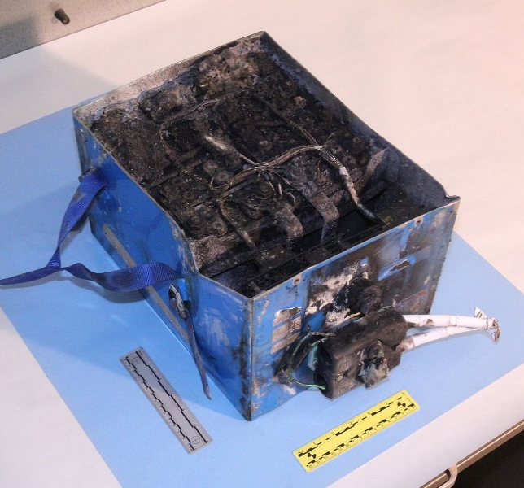

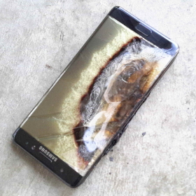
1.6 Potential risks when using lithium-ion batteries
Behavior of battery cells under proper operating conditions
  reliable, hardly failures with severe consequences
  millions of battery cells serve their purpose day in day out without attracting attention
Severe failures: very rare, but damages with serious consequences, attracting media attention
Dreamliner
Model S
Galaxy Note 7
[TOR]
[PHO]
Notes:
Dreamliner battery Bild: Public Domain

Slide 16
1.6 Potential risks when using lithium-ion batteries
Behavior of battery cells under different abuse conditions
Rule of thumb: Thermal energy released during thermal runaway corresponds to 5-7 times the
electrically available energy content
 | Overcharge | Overdischarge | Short Circuit
Effects | Irreversible damage to cathode material Decomposition of electrolyte Accelerated heating Decomposition of protective passivation layer on anode surface Thermal Runaway | Dissolution of copper ions from anode current collector Copper deposition in close proximity to separator Growth of dendrites Internal short-circuit Accelerated heating Thermal Runaway | High initial short circuit currents owing to low internal resistances Massive inhomogeneity in lithium-ion distribution Irreversible damage to active material and electrolyte Accelerated heating Thermal Runaway
Notes:
Typische Annahme: Votrag Harry Döring AABC

Slide 17
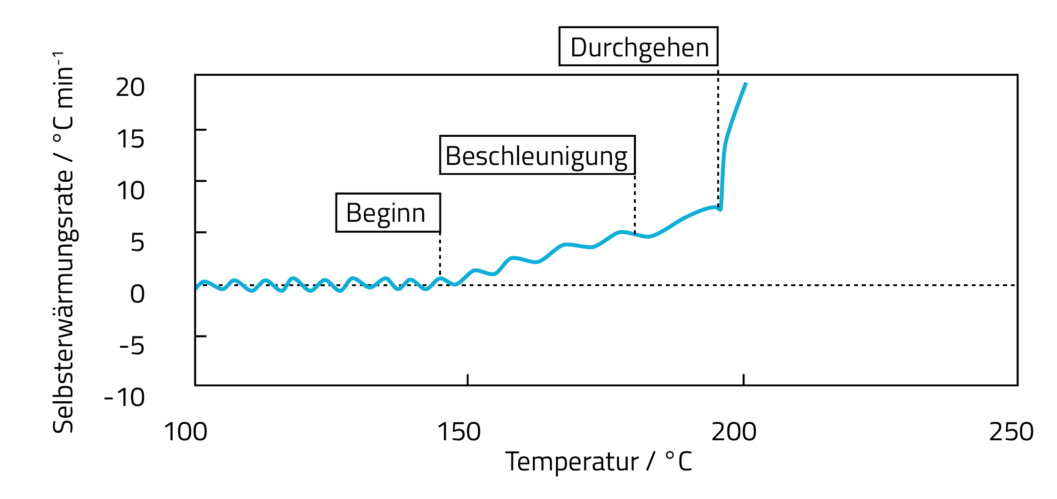
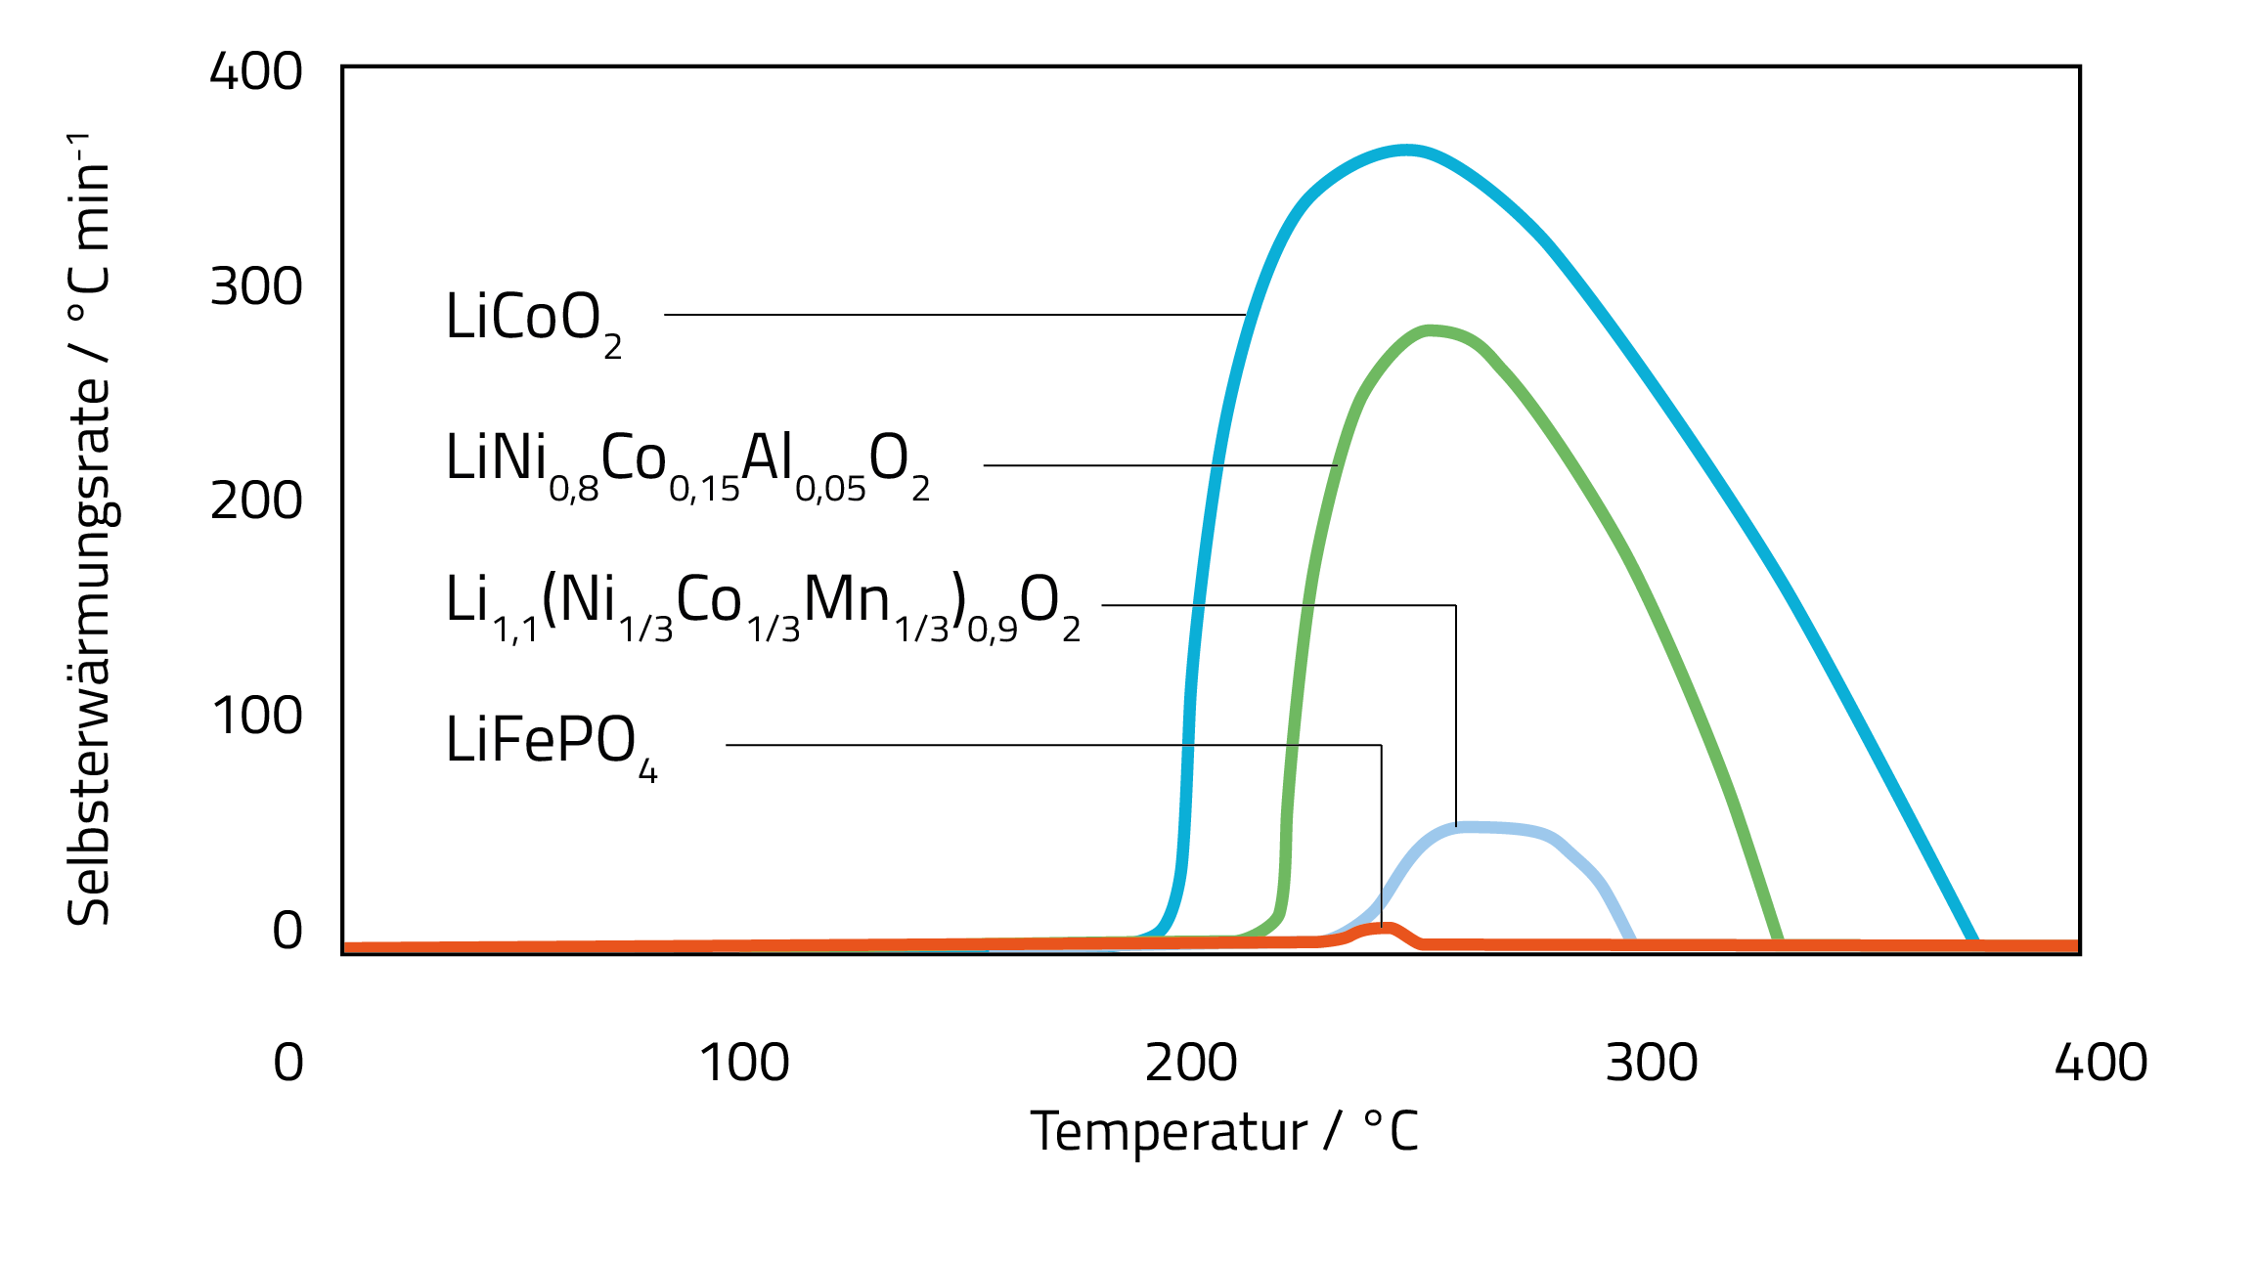
1.6 Potential risks when using lithium-ion batteries
Runaway
Thermal Runaway
  Exothermal self heating starting at 80-150°C
  Self-enhancing decomposition reaction of battery materials can lead to uncontrollable temperature rise
  Thermal Runaway: self heat rate >10 °C/min
  Decomposition products of the electrolyte are easily inflammable and lead to pressure increase in cell
  Melting of the separator can cause an internal short-circuit
  Decomposition of lithium metal oxide cathode materials releases oxygen: lithium-ion batteries burn also in oxygen-free environments
  Runaway propagation to neighboring cells in battery modules
  => fatal chain reaction, massive heat release
Acceleration
Onset
Self-Heat Rate (°C/min)
Temperature (°C)
Self-Heat Rate (°C/min)
[DOU]
Temperature (°C)
Notes:
Doughty, D.H.; Pesaran, A.A.: Vehicle Battery Safety Roadmap Guidance, NREL/SR-5400-54404, 2012

Slide 18
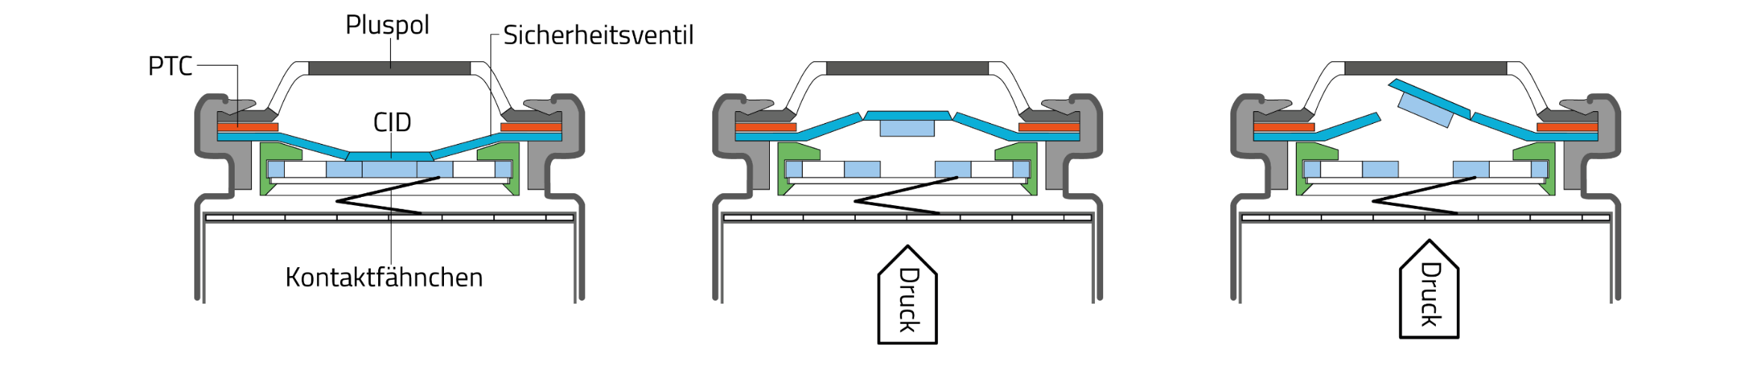
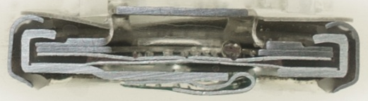
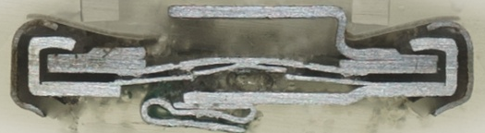
1.7 Safety concepts on cell level
PTC element (Positive Temperature Coefficient)
  Conductive polymer with increasing resistance at higher temperatures
  Limitation of current flow at critical temperature rise
CID element (Current Interrupt Device)
  Cuts current path irreversibly in case of an overpressure inside the cell
Pressure release valve
  Bursting of cell housing in case of excessive overpressure preventing an explosion of the cell
  Must not be covered / blocked in battery systems
Advanced separators
  Shutdown separator (PP/PE/PP), sealing of separator pores when PE melts, interruption of current flow
  Ceramic coatings preventing short-circuits under overheating conditions
Positive Terminal
Vent
CID good
CID tripped
Tab
[MÄH]
Pressure
Pressure
Notes:
Battery University Schulung

Slide 19
2 Battery Systems (AJ, 90 min)
2.1 Parallel and serial interconnection of cells
2.2 Concepts for safe and reliable battery systems
2.3 Battery management system
2.4 Thermal management: cooling and heating strategies
2.5 Impact of temperature on battery performance
2.6 Inhomogeneities in battery systems
2.7 Mechanical stress owing to cell deformation

Slide 20
2.1 Parallel and serial interconnection of cells
Parallelschaltung
Serienschaltung
Verschaltung von Einzelzellen zur Erhöhung des Energieinhalts
Parallelschaltung: Erhöhung der Kapazität,
Aufteilung der Strombelastung
Serienschaltung: Erhöhung der Spannungslage
Typischer Auslegungsprozess eines Batteriesystems
Betriebsspannungsbereich der Last bestimmt die Anzahl der benötigten Zellen in Serie
Der benötigte Energieinhalt liefert dann die erforderliche Kapazität des Batteriespeichers
Je nach Zelltyp lässt sich die Kapazität durch eine Zelle oder durch eine Parallelschaltung mehrerer Zellen erreichen
Sicherstellen, dass Maximalstrom des Verbunds ausreichend ist, ansonsten weitere Zellen parallel schalten
Spannung U_{System} = U_{Zelle}
Strom I_{System} = n_{p} · I_{Zelle}
Kapazität C_{System} = n_{p} · C_{Zelle}
Energie E_{System} = n_{p} · E_{zelle}
n_{p}
Spannung U_{System} = n_{s} · U_{Zelle}
Strom I_{System} = I_{Zelle}
Kapazität C_{System} = C_{Zelle}
Energie E_{System} = n_{s} · E_{zelle}
n_{s}

Slide 21
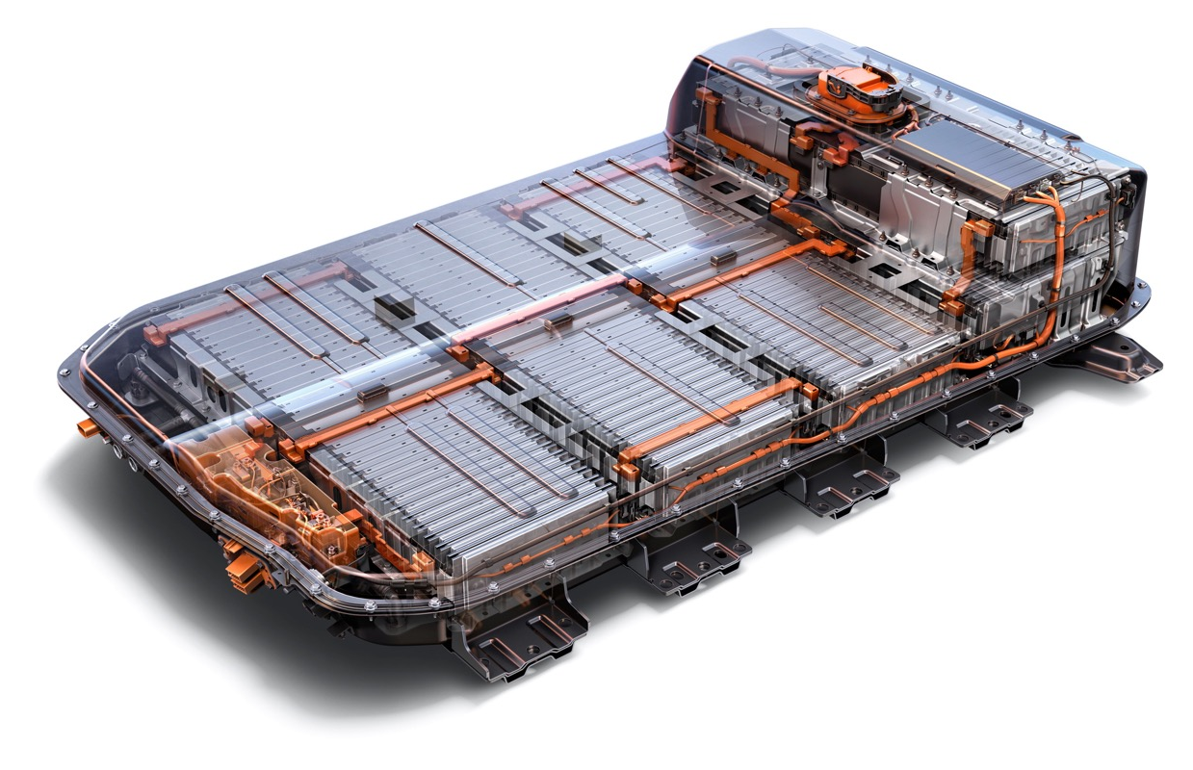
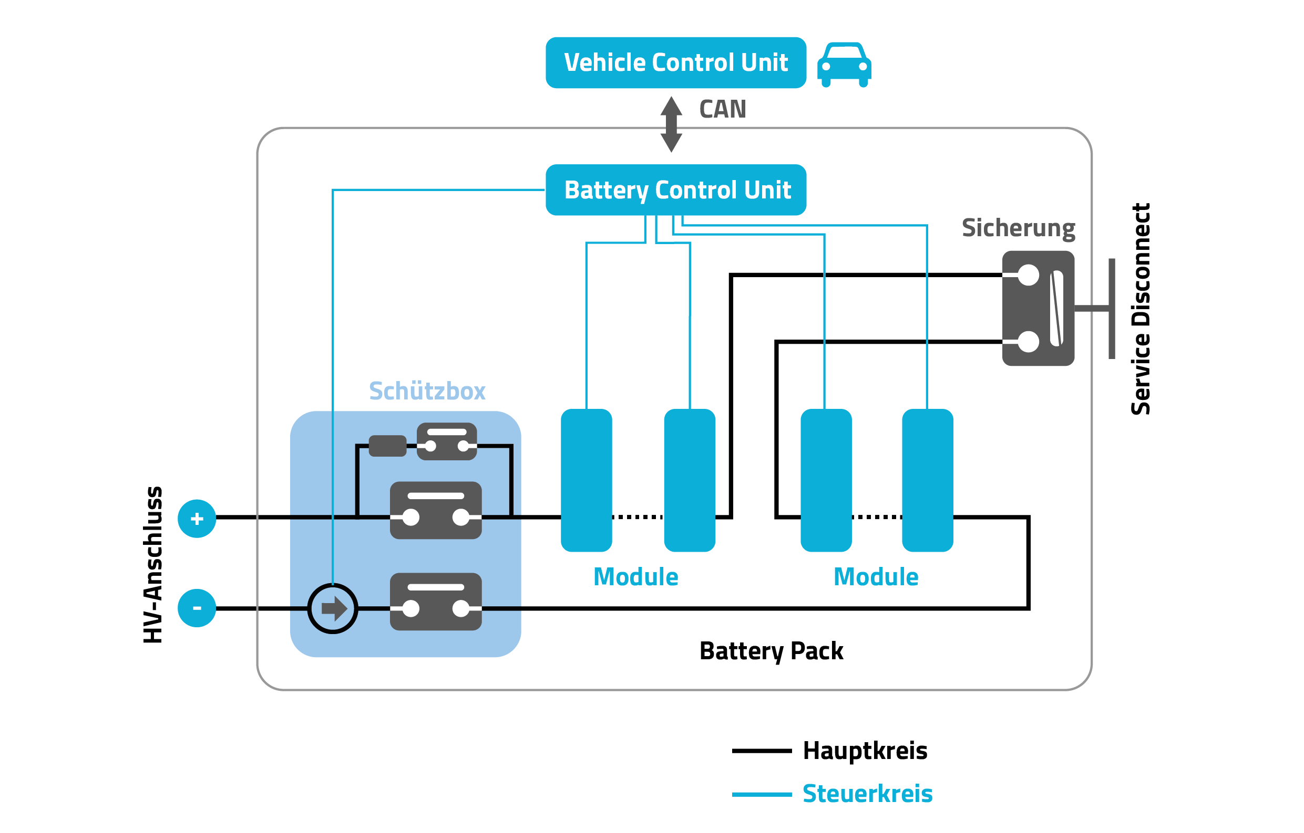
2.4 Concepts for safe and reliable battery systems
Batterie-Management-System
  Permanente Überwachung der Einzelzellspannungen, des Batteriestroms und der Batterietemperatur
  Freigabe der Batteriespannung erst nach erfolgreicher Kommunikationssequenz
  Pilot-/Lebens-Linie, die bei Ausfall von sicherheitsrelevanten Einzelkomponenten den Batteriespeicher abschaltet
Relais / Schütze
  Allpoliges Unterbrechen des Strompfades
  Vorladen des Zwischenkreises
Schmelzsicherungen
  Irreversible Unterbrechung des Strompfades im Notfall
Isolationsüberwachung
  Überprüfung der Isolation von Hochvoltpotentialen gegenüber der Fahrzeugmasse eines Elektrofahrzeugs
Service Disconnect
  Unterbrechung des Strompfades für Wartungsarbeiten
Batteriesystem
Chevrolet Bolt
[GMA]
nach [INS]
Notes:
http://insideevs.com/nissan-leaf-battery-nerdgasm/

Slide 22
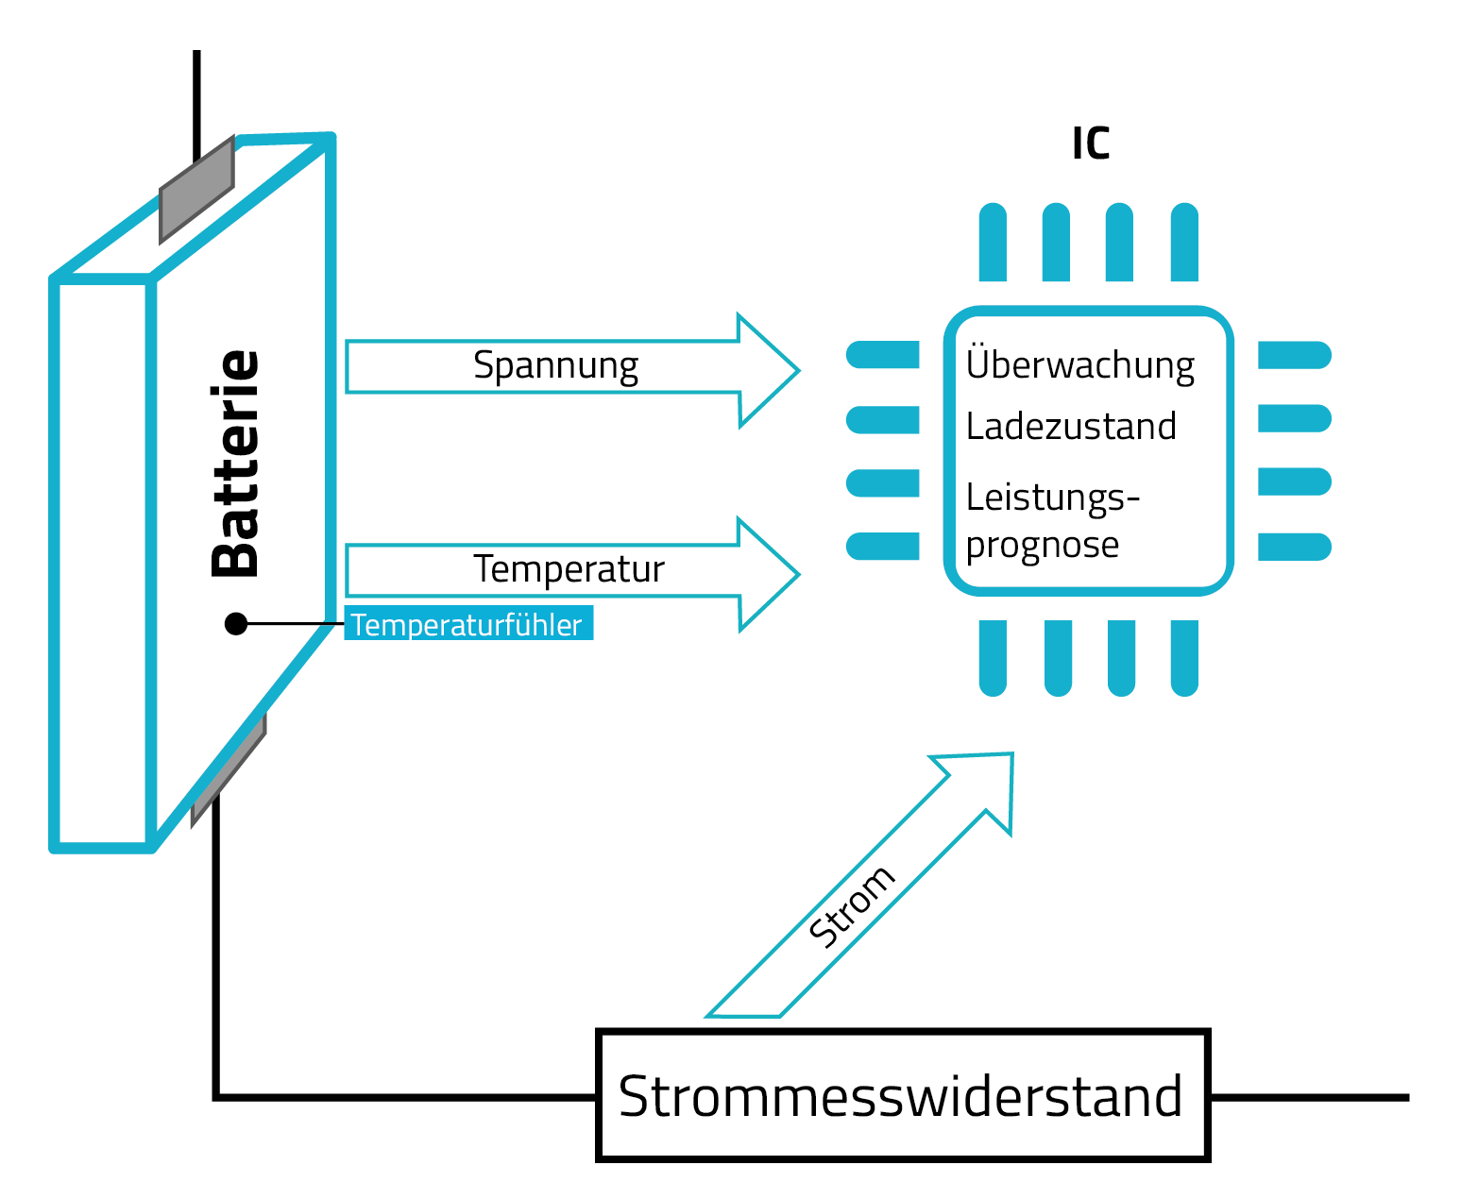
4.3 Batterie-Management-System (BMS)
Batterieüberwachung
  Strom
  Einzelzellspannungen
  Temperatur
Zustandsbestimmung
  Ladezustand (SoC)
    Anhand der Zellspannungen
    Integration der eingeladenen und entnommenen Ladungsmengen
  Maximale aktuelle Lade- / Entladeleistung
  Reichweitenschätzer
  Gesundheitszustand (SoH)
    Aktuelle Batteriekapazität
    Maximale Leistungsfähigkeit

Slide 23
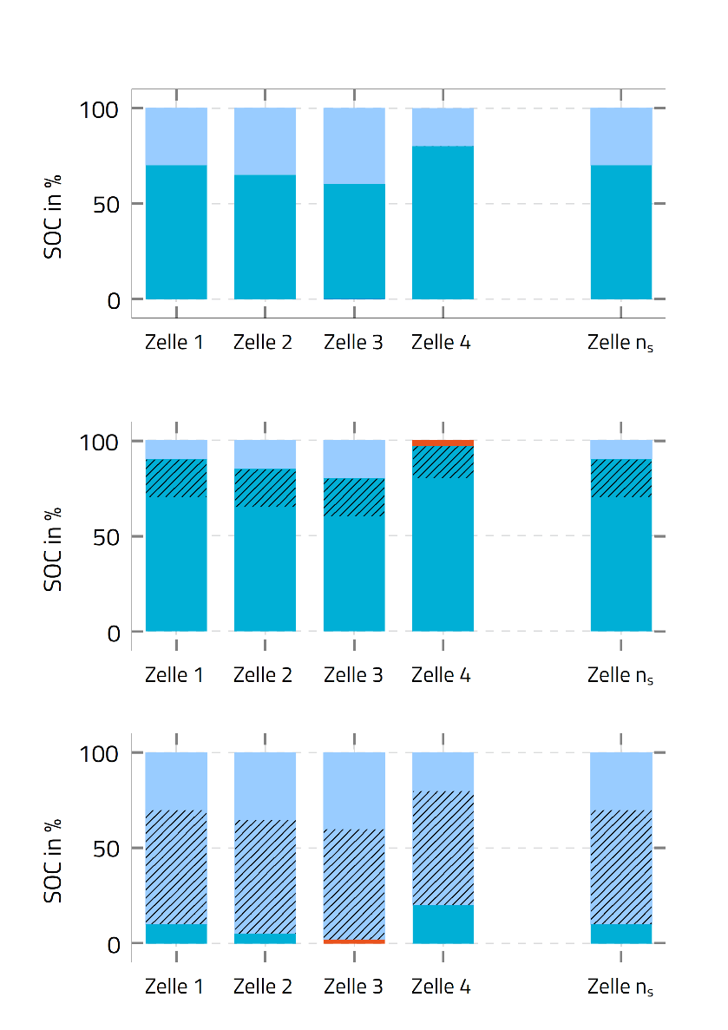
2.3 Batterie-Management-System (BMS)
Unterschiedliche Ladezustände bei Reihenschaltung
Nutzbare Kapazität beim Laden und Entladen
Problemstellung
  Unterschiedliche Ladezustände bei Serienschaltungen,
  z.B. infolge von Fertigungstoleranzen oder unterschiedlicher Selbstentladung
  Vollste Zelle limitiert den Ladevorgang
  Leerste Zelle limitiert den Entladevorgang
Ladungsausgleich
  Meist rein dissipativ über das Zuschalten eines parallelen Widerstands bei volleren Zellen während des Ladens
  Alternativ: induktives oder kapazitives Umladen

Slide 24
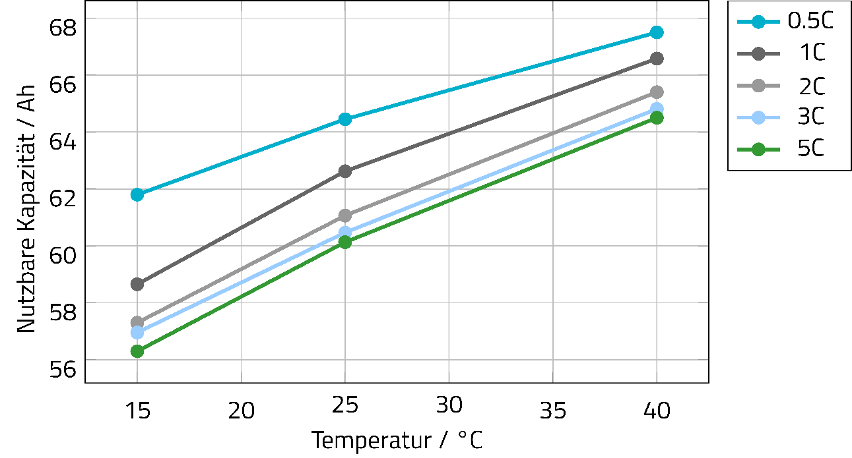
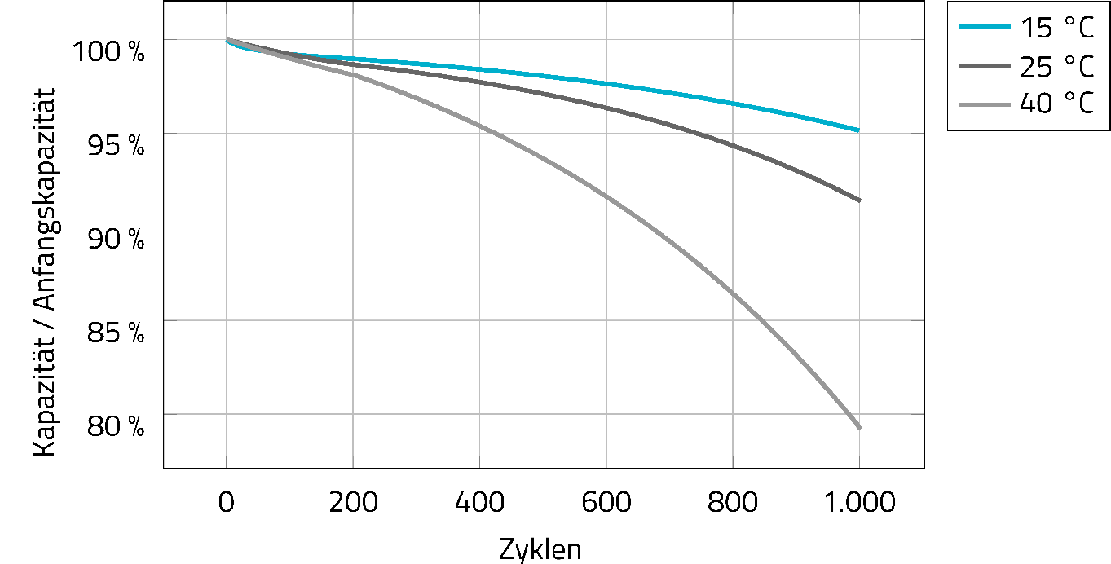
2.4 Thermal Management
Ziele:
  Abfuhr der Verlustwärme
  Vorheizen bei kalten Umgebungstemperaturen
  Reduktion der Batteriealterung
  Vermeidung von Temperaturgradienten

Slide 25
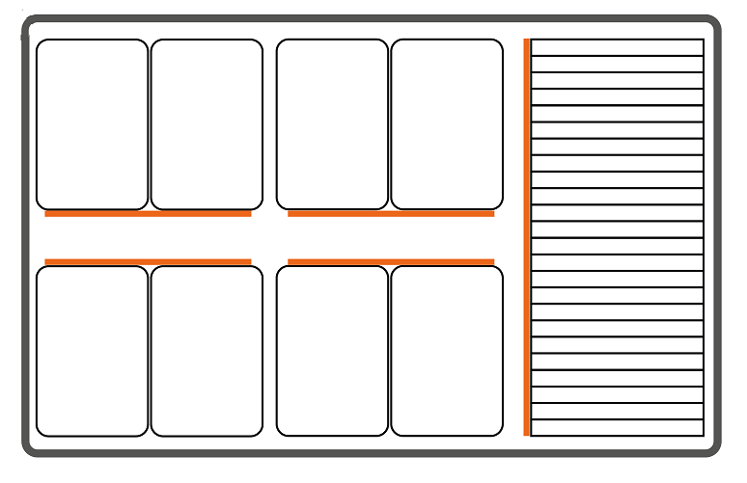
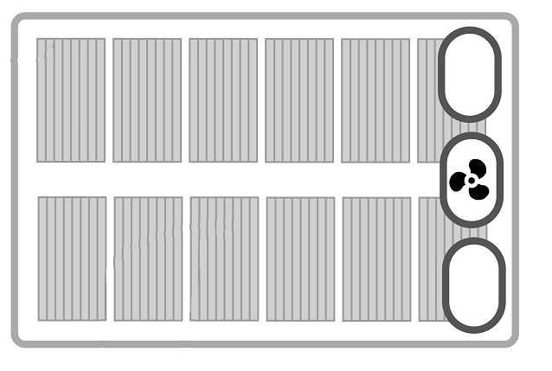
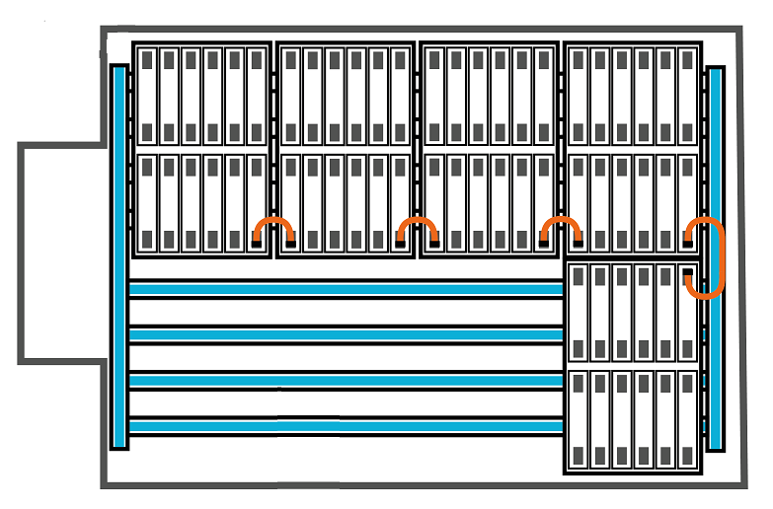
2.4 Thermal Management
 | Keine aktive Kühlung | Luftkühlung | Flüssigkeitskühlung / Kältemittelkühlung
Vorteile | + Keine Zusatzkosten + Kein zusätzlicher Bauraum + Geringe Temperaturgradienten + Verschlossenes Batteriesystem | + Mittlere Wärmeabfuhr mittels erzwungener Konvektion + Moderate Kosten | + Bester Wärmeaustausch + Verschlossenes Batteriesystem
Nachteile | − Nur Wärmestrahlung und natürliche Konvektion − Geringster Wärmeaustausch | − Zusätzlicher Bauraum für Lüfter und Lüftungskanäle − System offen für Fremdkörper − evtl. ungleichmäßige Durchströmung | − Höchste Kosten − Zusätzlicher Bauraum für Pumpe und Wärmetauscher − Stärkste Temperaturgradienten

Slide 26
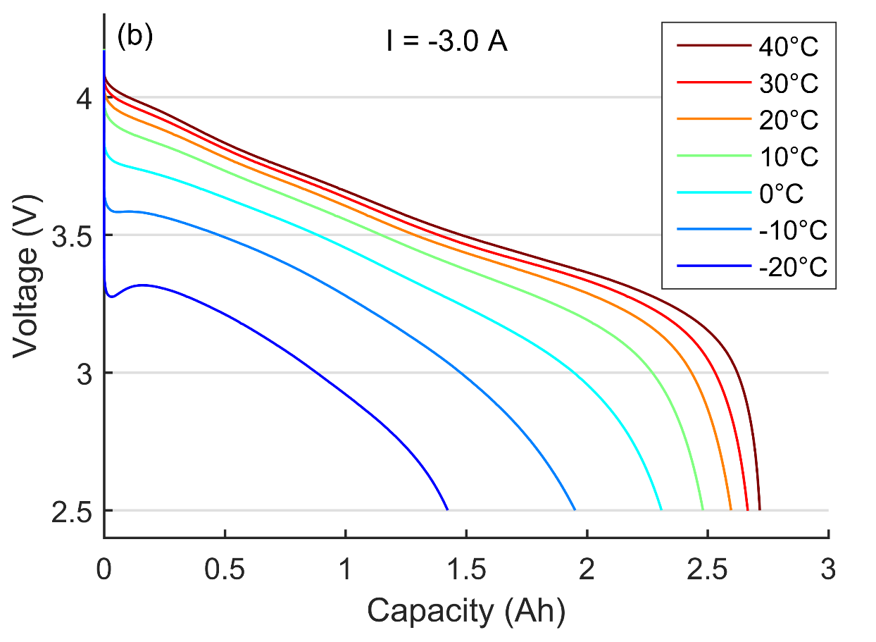
2.5 Impact of temperature on battery performance
Nutzbare Batteriekapazität
Nutzbare Kapazität nimmt bei niedrigen Temperaturen ab
Verfügbare Energiemenge sinkt zusätzlich durch die stärkeren Spannungsabfälle
Unterhalb von 0 °C häufig deutliche Einbrüche
Hochenergiezellen sind besonders anfällig gegenüber tiefen Betriebstemperaturen
Vorheizen oder Deaktivierung der Kühlung bringt Batterie in bessere Arbeitsbereiche
=> bessere Ausnutzung der gespeicherten
Energie durch thermische Konditionierung

Slide 27
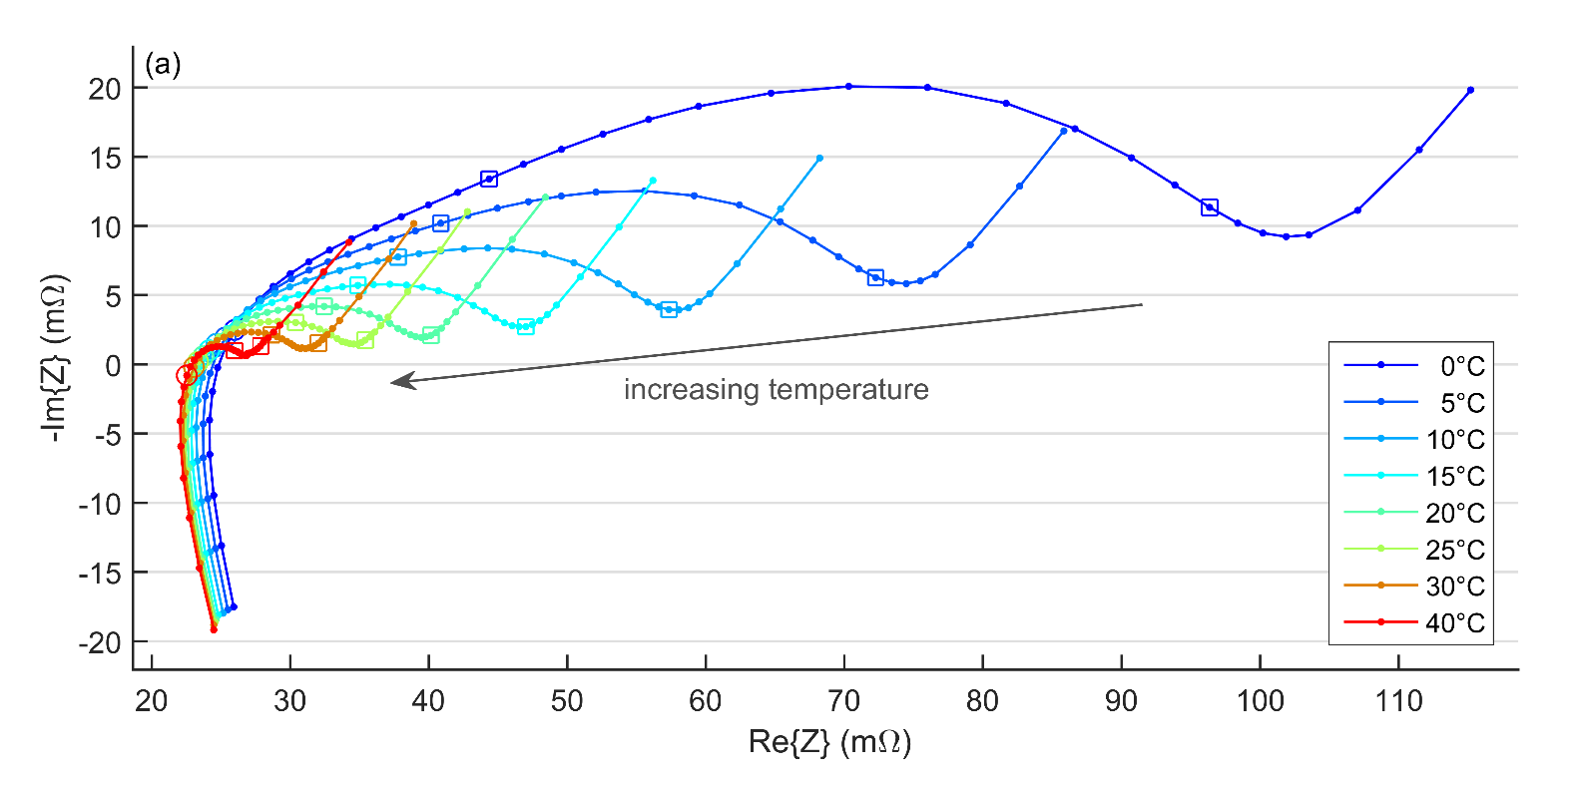
2.5 Impact of temperature on battery performance
Innenwiderstände
Innenwiderstände nehmen bei niedrigen Temperaturen stark zu
Rechtsverschiebung des Impedanz-spektrums im hochfrequenten Bereich steht für reduzierte Elektrolytleitfähigkeit
Massive Widerstandszunahme im Bereich der kapazitiven Halbkreisbögen
=> Erhöhte Ladungsdurchtritts-Widerstände
infolge langsamer ablaufender
elektrochemischer Reaktionen
Erhöhte Innenwiderstände beeinträchtigen die Leistungsfähigkeit
steigende Temperatur

Slide 28
2.6 Inhomogeneities in battery systems
Temperature gradients in battery modules
item1
item2
item3
item4

Slide 29
2.6 Inhomogeneities in battery systems
Current distribution in parallel connections
impact of capacity and resistance differences
item2
item3
item4

Slide 30
2.7 Mechanical stress owing to cell deformation
Expansion and contraction of lithium-ion cells during charging and discharging
item1
item2
item3
item4

Slide 31
2.7 Mechanical stress owing to cell deformation
Reversible and irreversible thickness changes
item1
item2
item3
item4

Slide 65
3 Battery Aging
3.1 Main degradation mechanisms in lithium-ion cells
3.2 Combination of usage-independent calendar aging and cycle aging
3.3 Performance loss owing to capacity fade and resistance increase
3.4 Impact of temperature and current rate on degradation
3.5 Strategies for maximizing battery life

Slide 66
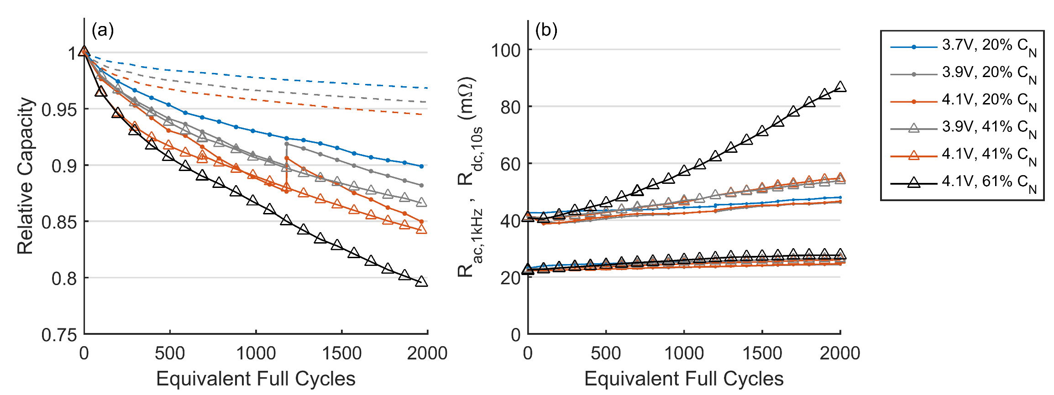
3.0 General effects of battery aging
Exemplary results of an experimental battery aging study
In-depth understanding of battery degradation necessary to identify the root causes for
capacity fade and increasing resistances
Capacity Fade
Increasing Cell Resistances
Storage
Low-Frequency Resistance
Cycling
High-Frequency Resistance

Slide 67
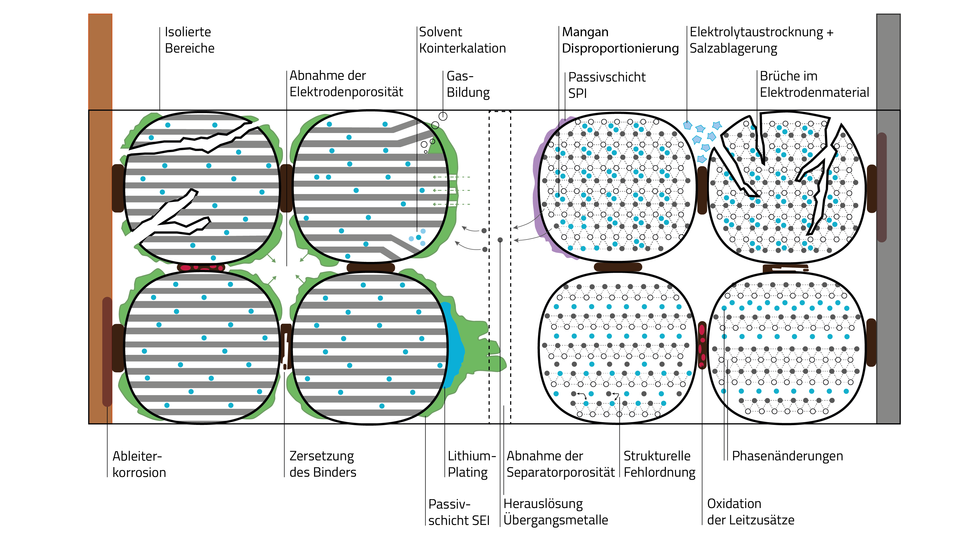
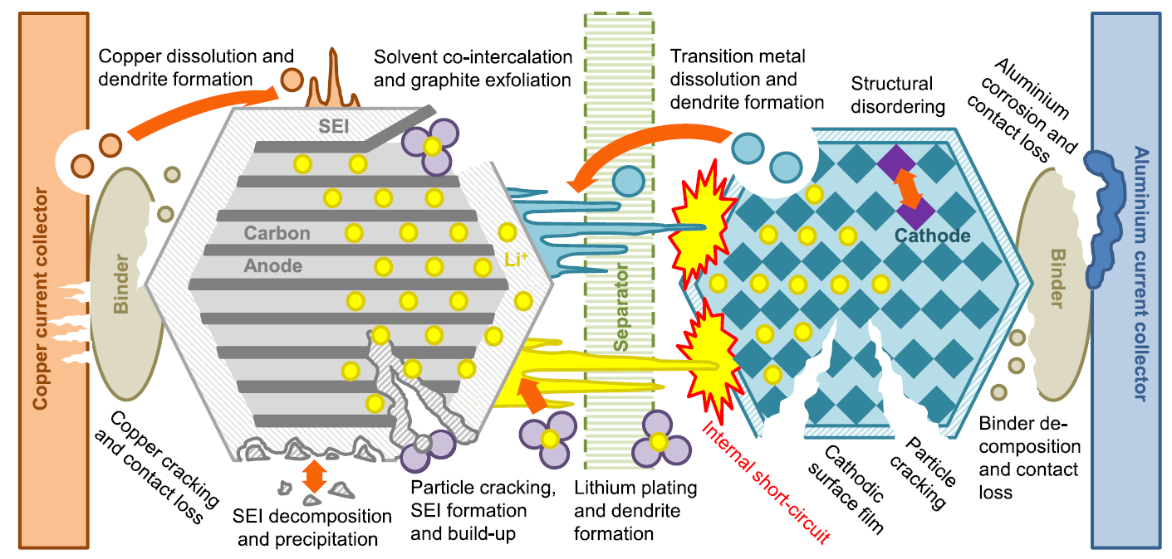
3.1 Main degradation mechanisms in lithium-ion cells
nach Merla et al., J. Power Sources
Overview over various degradation mechanisms in lithium-ion cells
Aging affects all battery components
[BIR]
Notes:
Birkl: Degradation diagnostics for lithium ion cells, Journal of Power Sources 341 (2017) 373-386
[1] Y. Merla, B. Wu, V. Yufit, N.P. Brandon, R.F. Martinez-Botas, G.J. Offer, Novel application of differential thermal voltammetry as an in-depth state-of-health diagnosis method for lithium-ion batteries, Journal of Power Sources 307 (2016) 308–319.

Slide 68
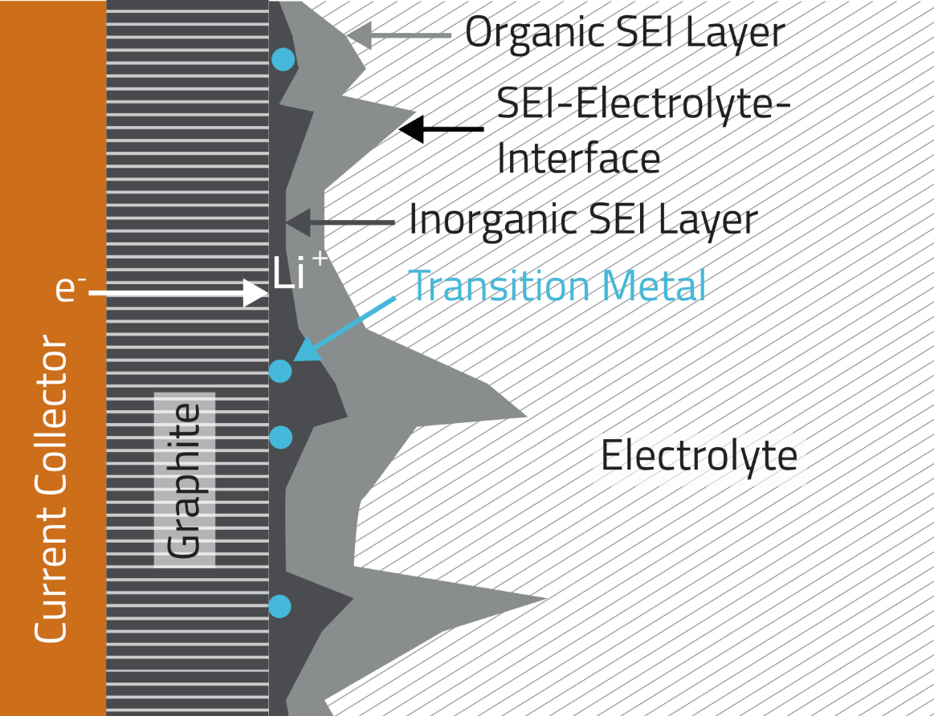
3.1 Main degradation mechanisms in lithium-ion cells
Electrolyte decomposition I: Reduction
Electrolyte of lithium-ion batteries is operated beyond its stability window
Reduction of electrolyte solvent and decomposition of conducting salt
Formation of an passivation layer at the anode: Solid Electrolyte Interphase (SEI)
Ideal SEI:
  conductive for lithium ions
  non-conductive for other electrolyte components
  robust and stable for achieving a long battery life
  thin to not unnecessarily increase cell resistance
[JOS]
Degradation effect: Capacity fade resulting from a loss of cyclable lithium
Influencing factors: Anode potential, temperature
Notes:
[1] T. Joshi, K. Eom, G. Yushin, T.F. Fuller, Effects of Dissolved Transition Metals on the Electrochemical Performance and SEI Growth in Lithium-Ion Batteries, Journal of the Electrochemical Society 161 (12) (2014) A1915-A1921.
[1] M. Gauthier, T.J. Carney, A. Grimaud, L. Giordano, N. Pour, H.-H. Chang, D.P. Fenning, S.F. Lux, O. Paschos, C. Bauer, F. Maglia, S. Lupart, P. Lamp, Y. Shao-Horn, Electrode-electrolyte interface in Li-ion batteries: current understanding and new insights, The journal of physical chemistry letters 6 (22) (2015) 4653–4672.
Passivschichtbildung: Solid Electrolyte Interphase (SEI)

Slide 69
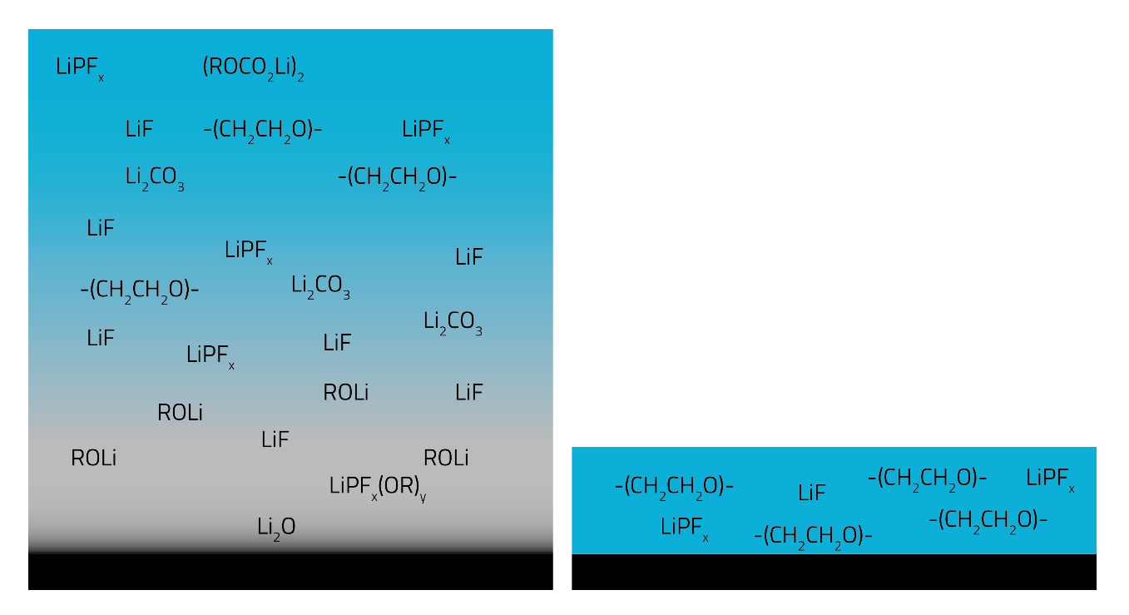
3.1 Main degradation mechanisms in lithium-ion cells
Electrolyte decomposition II: Oxidation
Electrolyte oxidation can occur at high cathode potentials
Passivation layer also at the cathode:
Solid Permeable Interphase (SPI)
Electrolyte decomposition (Reduction & Oxidation)
Lowers electrolyte conductivity
Risk of (local) drying-out
Increasing internal pressure by gaseous reaction products
Can be reduced by certain electrolyte additives
Anode Passivation Layer (SEI)
Cathode Passivation Layer
[MAL]
Degradation effect: Increasing resistances, inhomogeneous load distribution
Influencing factors: Cathode potential, temperature
Notes:
[1] S. Malmgren, K. Ciosek, M. Hahlin, T. Gustafsson, M. Gorgoi, H. Rensmo, K. Edström, Comparing anode and cathode electrode/electrolyte interface composition and morphology using soft and hard X-ray photoelectron spectroscopy, Electrochimica Acta 97 (2013) 23–32.

Slide 70
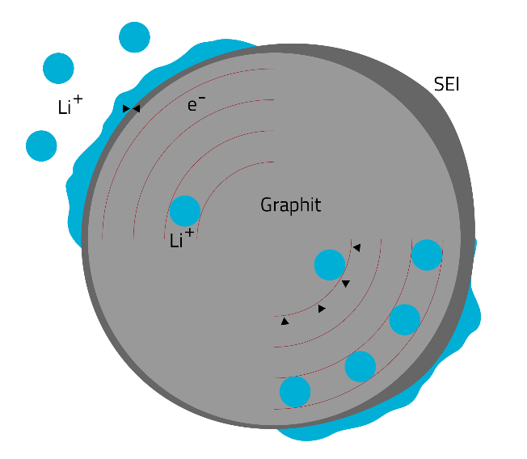
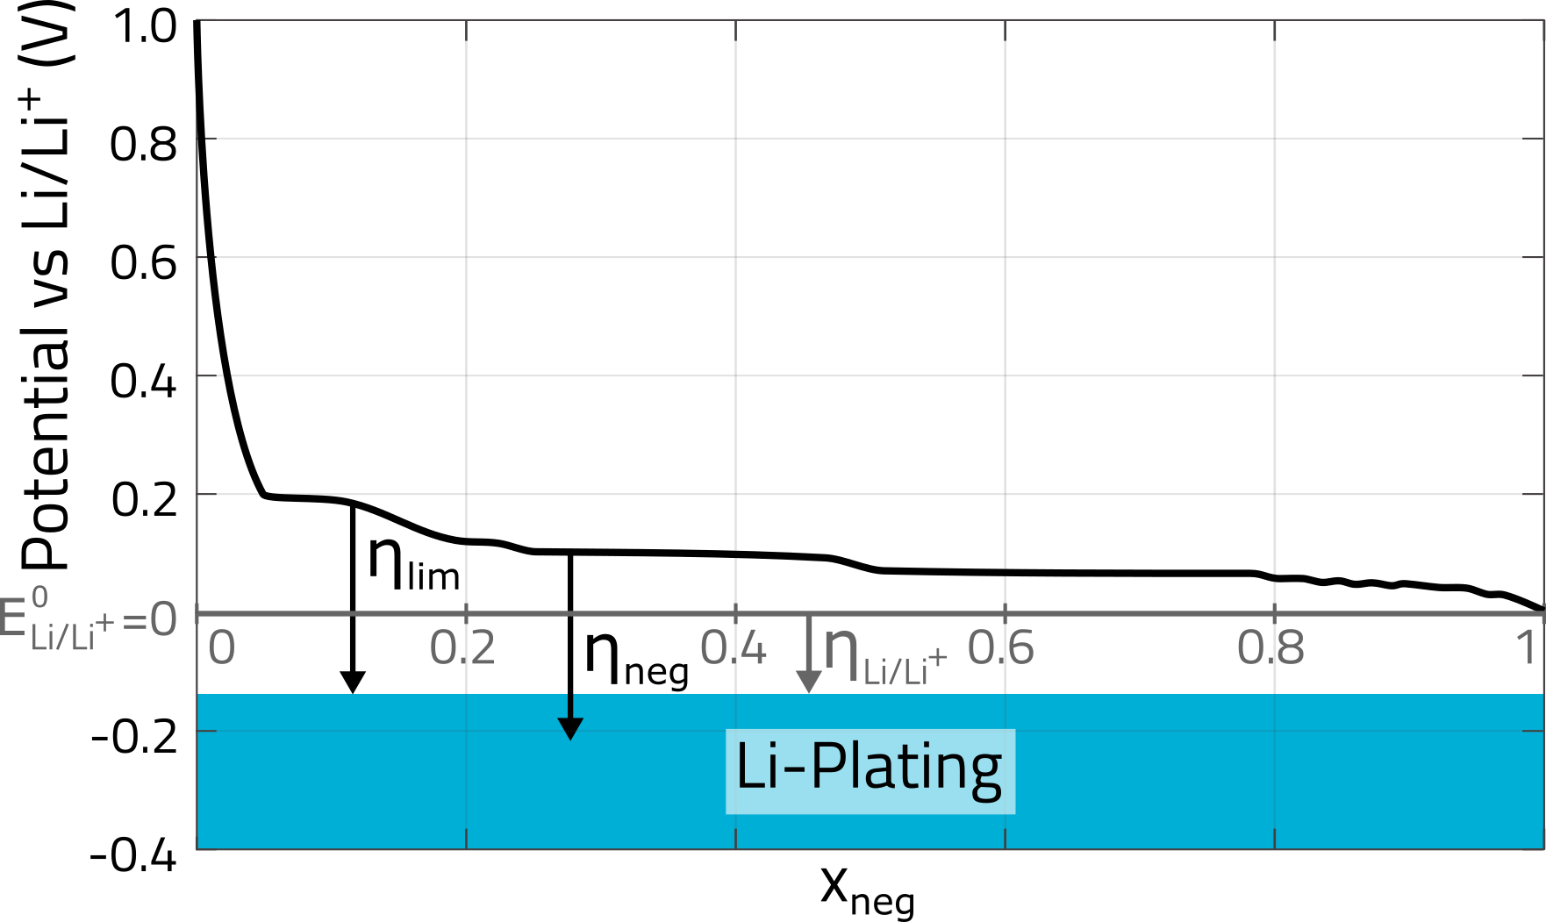
3.1 Main degradation mechanisms in lithium-ion cells
Lithium plating at the anode
Mechanism of lithium plating:
Deposition of metal lithium at the surface of the graphite particles during charging instead of a lithium intercalation
Causes: Charge transfer limitation or
solid diffusion limitation
Effect: Mostly dissolution and reintercalation,
partially irreversible side reactions with
electrolyte
charge transfer limitation
Graphite
solid diffusion limitation
[LEG]
Degradation effect: Capacity fade resulting from a loss of cyclable lithium
Notes:
[1] N. Legrand, B. Knosp, P. Desprez, F. Lapicque, S. Raël, Physical characterization of the charging process of a Li-ion battery and prediction of Li plating by electrochemical modelling, Journal of Power Sources 245 (2014) 208–216.

Slide 71
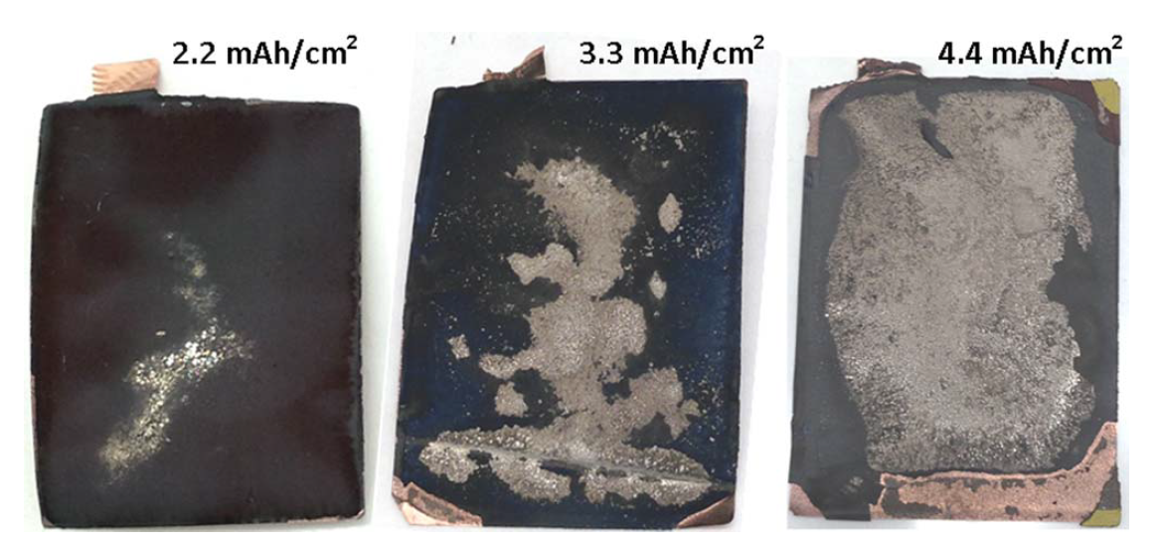
3.1 Main degradation mechanisms in lithium-ion cells
Lithium plating at the anode
Factors increasing the risk of lithium plating:
Lower anode potential at high states of charge
High charging currents
Low temperatures
High-energy electrode design
  Thick electrode layers
  Low porosity
  Slower lithium transport kinetics
Graphite anodes with different active material loadings
[GAL]
Influencing factors: Temperature, charging current, cell design
Notes:
[1] K.G. Gallagher, S.E. Trask, C. Bauer, T. Woehrle, S.F. Lux, M. Tschech, P. Lamp, B.J. Polzin, S. Ha, B. Long, Q. Wu, W. Lu, D.W. Dees, A.N. Jansen, Optimizing Areal Capacities through Understanding the Limitations of Lithium-Ion Electrodes, J. Electrochem. Soc. 163 (2) (2015) A138-A149.

Slide 72
3.1 Main degradation mechanisms in lithium-ion cells
Transition metal dissolution
Dissolution of transition metals (Mn, Ni, Co)
from the cathode lattice structure,
particularly at high states of charge
Exception: Manganese spinel LiMn₂O₄:
susceptible to manganese dissolution at medium states of charge
Aggravates with higher temperatures
Effects of transition metal dissolution:
  Migration of metal ions to the anode
  Reduction at the anode, intensifies SEI growth
  Consumption of cyclable lithium at the anode
Post-mortem study with anodes from
cycled graphite/NMC cells
[BUC]
Degradation effects: Increasing resistances, capacity fade from loss of cyclable lithium
Influencing factors: Cathode potential, temperature
Notes:
Bildquelle: I. Buchberger, S. Seidlmayer, A. Pokharel, M. Piana, J. Hattendorff, P. Kudejova, R. Gilles, H.A. Gasteiger, Aging Analysis of Graphite/LiNi 1/3 Mn 1/3 Co 1/3 O 2 Cells Using XRD, PGAA, and AC Impedance, J. Electrochem. Soc. 162 (14) (2015) A2737-A2746.

Slide 73
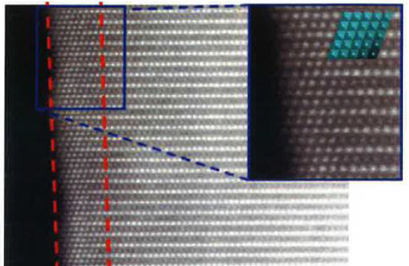
3.1 Main degradation mechanisms in lithium-ion cells
Structural changes in lithium metal oxide cathodes
Irreversible phase changes
  Collapsing layer structure
  when too much lithium is extracted from layered oxide materials (overcharge condition)
  Only 50-60% of the lithium may be extracted from layered lithium metal oxides (LCO, NMC, NCA)
  LFP more stable due to olivine structure,
  almost all of the lithium can be extracted
Rock-salt surface layers
  Exchange of lattice positions
  Metal atoms occupy lithium sites
  Lithium diffusion pathways blocked
[UMI]
Degradation effects: Increasing resistances, loss of storage capabilities of cathode active material
Influencing factors: Cycle depth, charging voltage, temperature
Notes:
Quelle: Umicore (S. Levasseur) – Insights into NMC degradation processes for high energy systems: How far can we push?
AABC Europe, Mainz, 2017

Slide 74
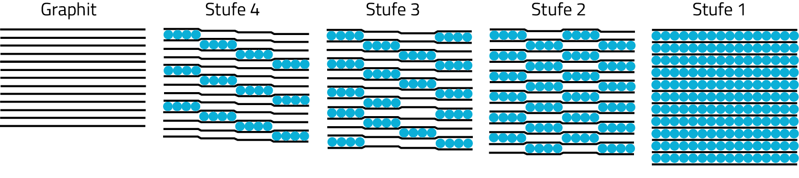
3.1 Main degradation mechanisms in lithium-ion cells
Mechanical stress in active materials
Expansion and contraction of active materials owing to the intercalation and deintercalation of lithium ions
Typical thickness changes of graphite electrodes: ca. 5%
Effects of volume changes:
  Micro-cracks in active material particles
  Weakening of particle-to-particle contacts
  Delamination from current collectors
  Cracks in SEI passivation layer at the anode,
  anode in contact with electrolyte again, which
  leads to new SEI formation (SEI crack and repair)
Graphite intercalation stages
[SET]
Micro-cracks in NCA cathode particles
[WAT]
Degradation effects: Capacity fade from loss of active material and cyclable lithium, increasing resistances
Influencing factors: Cycle depth, charging/discharging currents, temperature
Notes:
[1] G. Ning, B. Haran, B.N. Popov, Capacity fade study of lithium-ion batteries cycled at high discharge rates, Journal of Power Sources 117 (1-2) (2003) 160–169.
[1] V.A. Sethuraman, L.J. Hardwick, V. Srinivasan, R. Kostecki, Surface structural disordering in graphite upon lithium intercalation/deintercalation, Journal of Power Sources 195 (11) (2010) 3655–3660.

Slide 75

3.2 Combination of usage-independent calendar aging and cycle aging
General assumption: Linear superposition of calendar aging and cycle aging
Calendar aging
  Usage-independent degradation
  Aging during storage and inactivity periods
  Can also be dominant when cycling with low current rates and small cycle depths
Cycle aging
  Usage-dependent degradation
  Aging related to charging and discharging of the batteries
Typical End of Life (EoL) criteria:
[ State of Health (SoH) = 0 ]
  Capacity fade of 20-30 % C_{N}
  Doubling of internal resistances
Calendar Aging
Overall Aging
Cycle
Aging

Slide 76
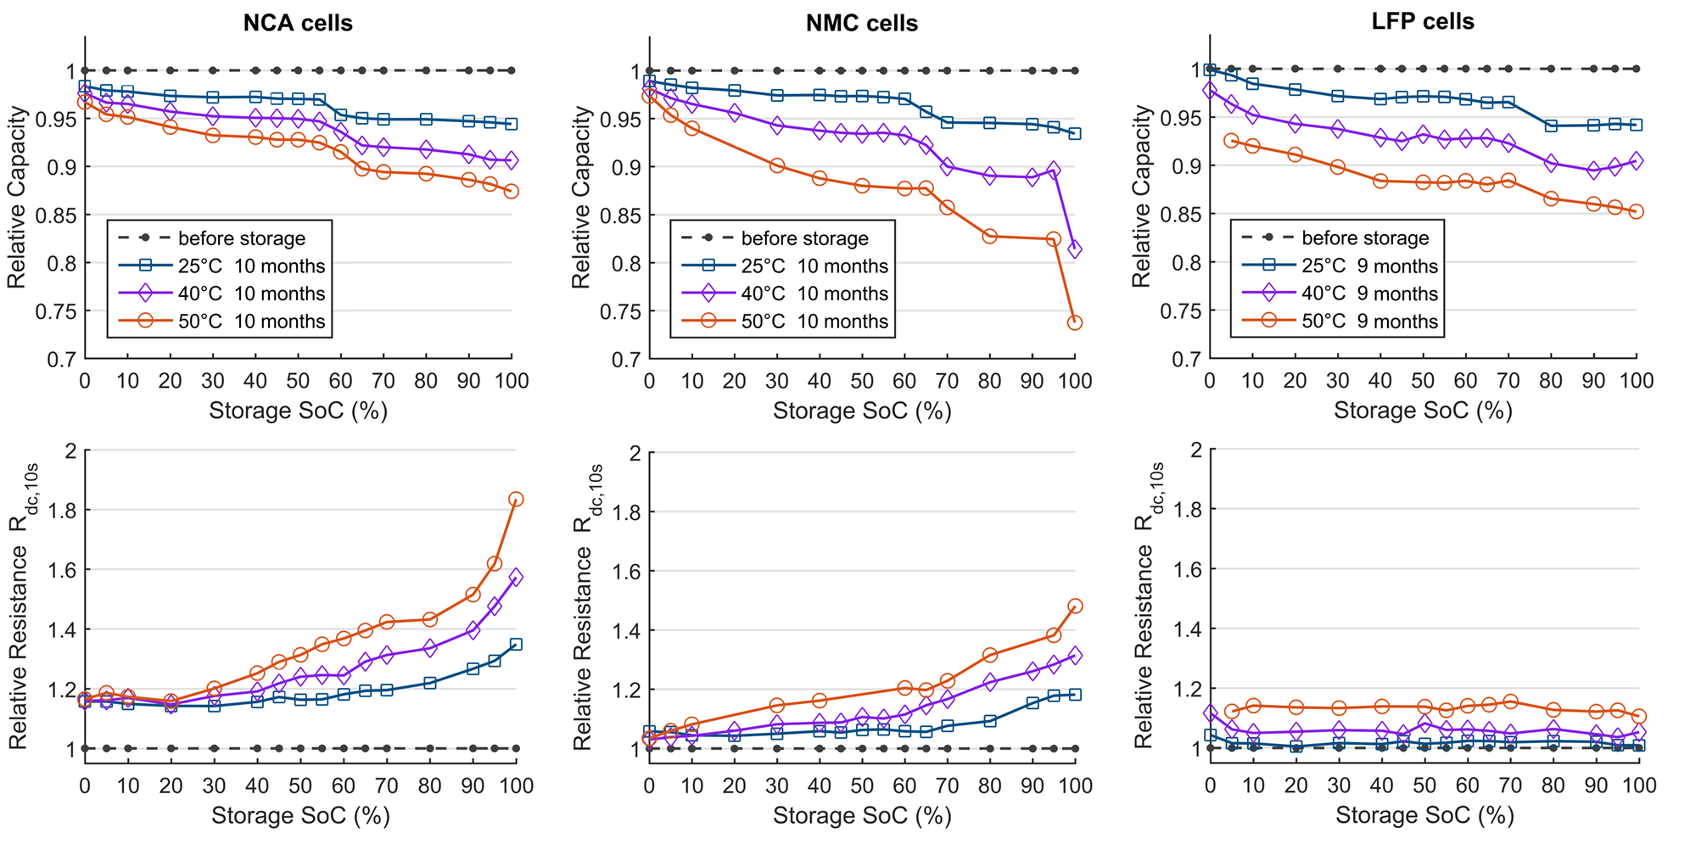
3.3 Performance loss owing to capacity fade and resistance increase
Calendar aging examined by long-term storage
Effects of battery degradation
  Different cell types exhibit different aging characteristics
  No clear interdependency between capacity fade and
  resistance increase
Storage experiments reveal side reactions at the contact surfaces between electrodes and electrolyte
  Mainly electrolyte decomposition and SEI growth at the anode
  Capacity fade owing to a loss of cyclable lithium
  Slight increase in high-frequency resistances (R_{ac,1kHz}) resulting from a reduced electrolyte conductivity
  Changes at the surfaces of the cathode active material particles leads to higher low-frequency resistances (R_{dc,10s})
Notes:
originaldatei

Slide 77
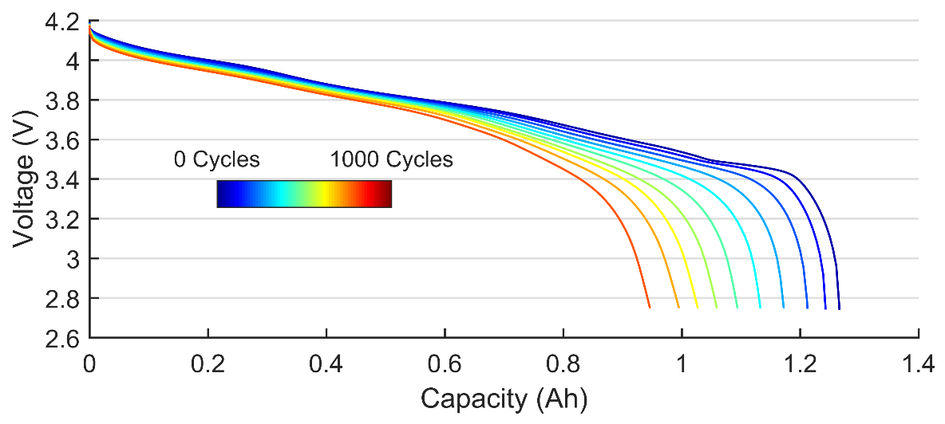
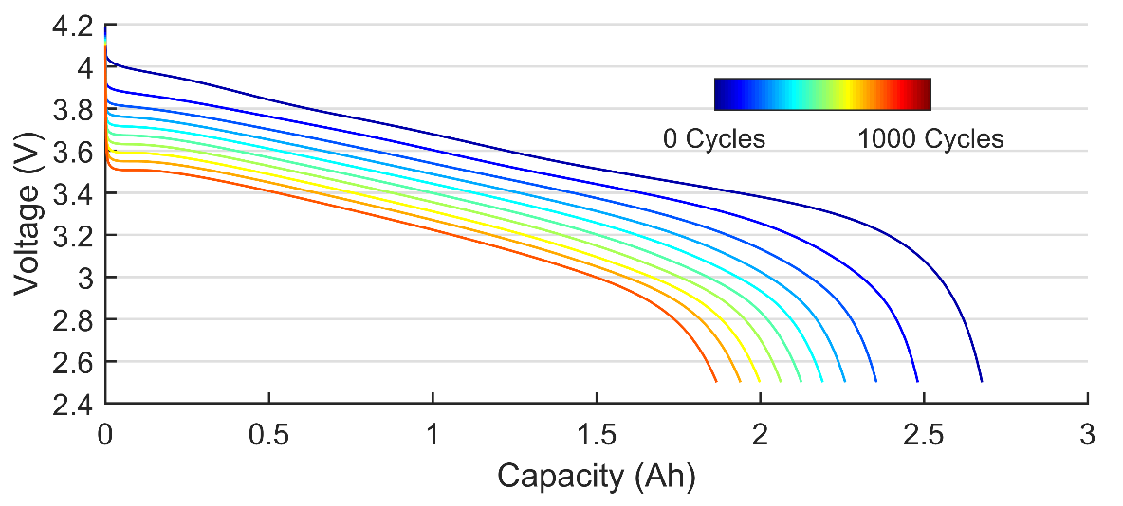
3.3 Performance loss owing to capacity fade and resistance increase
Cycling of a high-power cell
Cycling of a high-energy cell
Effects of battery degradation
  Different cell types exhibit different aging characteristics
  Increasing resistances generate higher heat losses
  No clear interdependency between capacity fade and
  resistance increase
  Detection of root causes require specific test procedures and experience
Application-dependence of end of life criteria
  High-energy applications, e.g. notebooks, electric vehicles: capacity most important criterion
  High-power applications, e.g. electric tools, planes:
  power capability more important
  -> resistance rise becomes most important criterion
Preferred cell types
  High-energy applications: NMC, NCA cells
  High-power applications: LFP, LMO cells
Capacity fade
Resistance increase
Capacity fade

Slide 78
3.3 Performance loss owing to capacity fade and resistance increase
Exemplary results of an experimental battery aging study
Capacity fade typically caused by loss of cyclable lithium owing to anodic side reactions (SEI growth)
Increasing high-frequency resistance generally caused by reduced electrolyte conductivity
Increasing low-frequency resistance typically caused by cathode material degradation
Capacity Fade
Increasing Cell Resistances
DoD 63%
Storage
DoD 21%
Low-Frequency Resistance
Cycling
DoD 21%
High-Frequency Resistance
DoD 63%

Slide 79
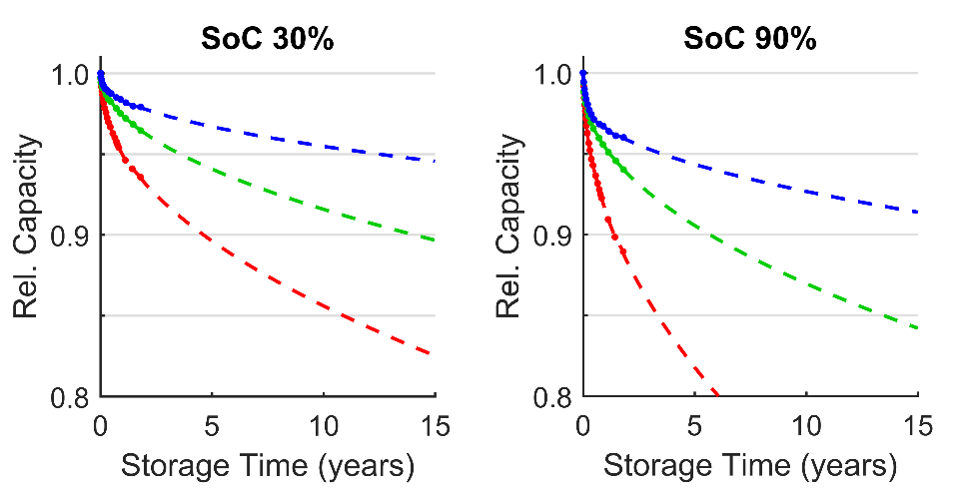
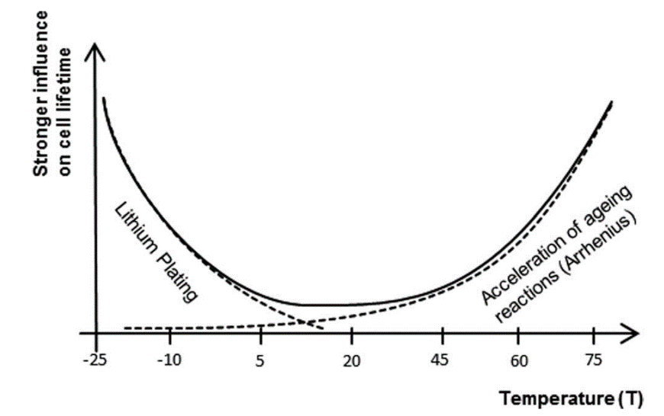
3.4 Impact of temperature and current rate on degradation
Impact of temperature on calendar aging
Impact of temperature on cycling
Calendar aging
  Accelerated aging with higher temperatures
  Side reactions between electrodes and electrolyte aggravate
  During storage, battery temperatures should be kept low
Cycle aging
  Degradation aggravates also with lower temperatures
  Risk of lithium plating when charging at low temperatures
  Also discharging with high currents at low temperatures stresses lithium-ion cells
  Ideal operating temperatures lie around 20-40°C
  Higher temperatures (up to 60°C) can also be tolerated when they occur only for a short period of time
10°C
25°C
40°C
[PRO]

Slide 80
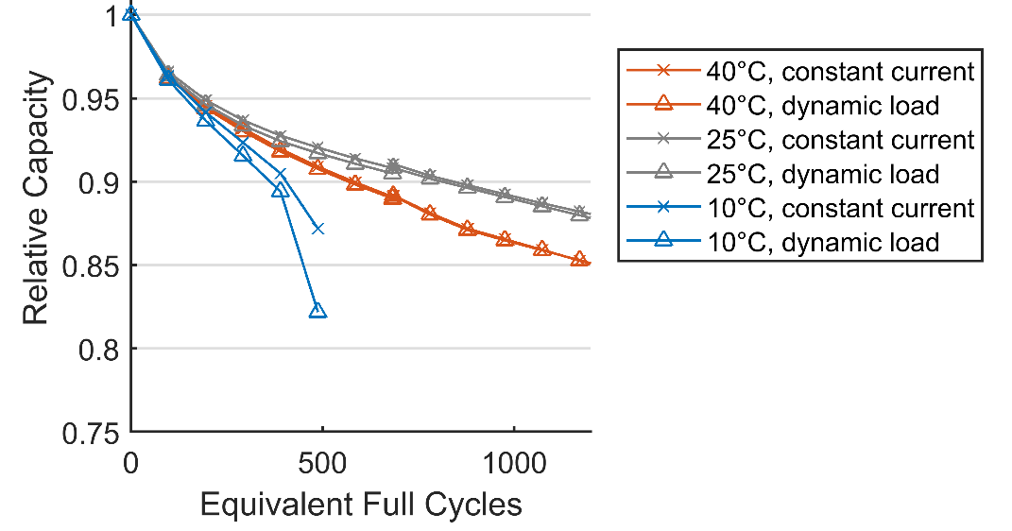
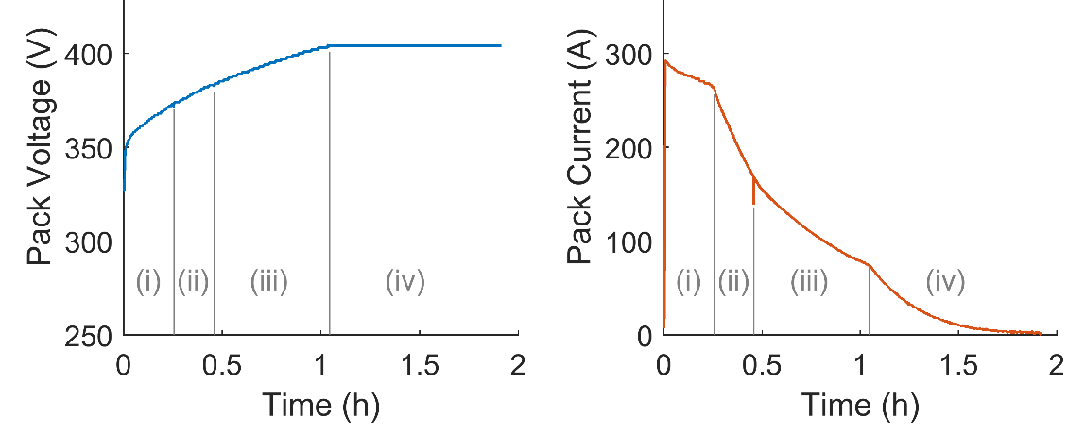
3.4 Impact of temperature and current rate on degradation
Comparison of different current load profiles
Tesla Supercharging
Lithium-ion batteries exhibit a certain low-pass behavior
  Average load usually determines degradation
  High current pulses (Hz … kHz domain) do not degrade battery life at moderate and warm temperatures
  At low temperatures (10°C and lower), the batteries become more susceptible to high current pulse loads
Optimizing charging process
  Fast charging protocols try to maximize the charging current without accelerating degradation massively
  High charging currents are only applied at low
  states of charge
  Continuous current reduction with increasing state of charge to reduce lithium plating
  However, the high charging currents in the beginning still increase degradation by a certain extent

Slide 81
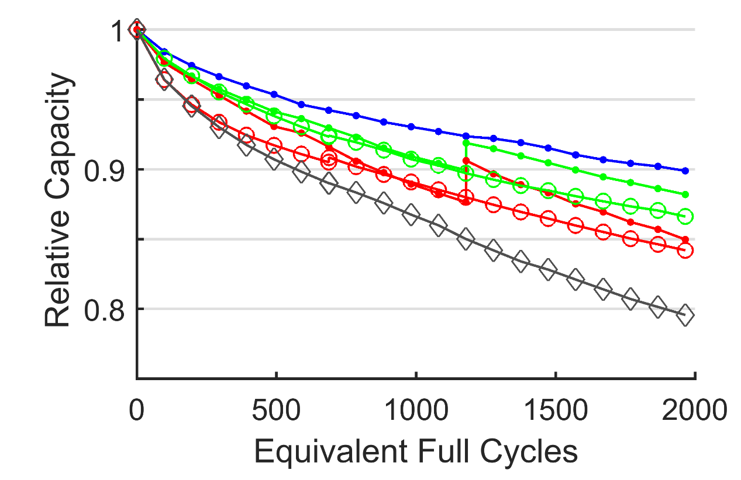
3.5 Strategies for maximizing battery life
Golden rules for a long battery life
Selection of correct cell type
  Select appropriate cell for specific application
  Weighing-off between energy content, power capability, and battery life
Appropriate temperature
  Storage at low temperature
  Operation at warm temperature
Reduce cycle depth
  When possible, perform more small partial cycles instead of few large/full cycles
Avoid long times at high SoCs
  Minimizing the effect of lowest anode potential
  Reducing electrolyte oxidation at high cathode potential
  Reducing the risk of lithium plating
DoD 21%
DoD 63%

Slide 83
4 Modelling and Simulation
4.1 Overview over modelling strategies for different length scales
4.2 Electrical and thermal simulation of lithium-ion batteries
4.3 Model parameterization and validation

Slide 84
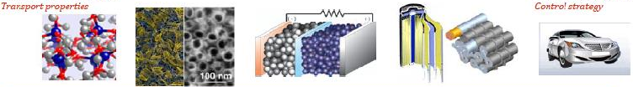
4.1 Overview over modelling strategies for different length scales
Model types for different length scales
[PES]
10⁻¹⁰ 10⁻⁸ 10⁻⁶ 10⁻⁴ 10⁻² 10⁰ (m)
Molecule
Particle
Electrode
Cell
Module
System
Kinetic effects
Lattice characteristic
and stability
Reaction at surface
Transport in active material
Particle mechanics
Mixed current flow (ionic, electronic)
Potential and concentration distribution
Current, potential, SoC and temperature distribution.
Heat balance
Electrical and thermal interactions
Operation strategies
Battery-
management
Physiko-chemical Models
Equivalent circuit Models (ECM)

Slide 85
4.1 Overview over modelling strategies for different length scales
R_{i}
U_{OCV}
Equivalent circuit models
Method
  Description of a cell by an electrical circuit
    Voltage source
    Impedance network
  Typically use of concentrated elements
  The impedance network is described by a wide variety in complexity by resistors, capacitors, inductivities and special electrochemical impedance elements
Advantages
  A wide range in speed and accuracy possible
  Selective model adjustment to different requirement is possible.
  Simple but time consuming parametrization
Disadvantages
  Limited relation between components and physical-chemical mechanism.
R_{i}
R₁
Computing speed
C₁
U_{OCV}
R_{i}
R₁
R₂
C₁
C₂
U_{OCV}
R₁
R₂
Z_{W}
R_{i}
C₁
C₂
U_{OCV}
Accuracy

Slide 86


4.1 Overview over modelling strategies for different length scales
Physico-chemical models
Methods
  Description of mass and charge balances in the electrolyte and the active material
  The charge transfer reaction describes the interface between both domains
Advantages
  Parameters are based on material properties and geometrical design.
  Models deliver space resolved Li-concentration and potentials
Disadvantages
  Complex numerical system:
  high computation requirements
  Parametrization is difficult:
  Detailed cell analyzes necessary to determine all parameters.
[ERH]

Slide 87

4.2 Electrical and thermal simulation of lithium-ion batteries
Simulation of an EV driving profile
Simple ECM (1st order)
  OCV
  Ri + 1 RC-element,
  parametrization for
  different SOC
Method for parametrization
  RC-element describes the low speed diffusion processes (minute range)
  Ri describes the high frequency resistance and the charge transfer (all fast effects)
Simulation accuracy
  Average voltage error: < 30 mV
  Only at low state of charge higher errors are seen
  Further improvement possible
Limitations
  Very high currents and low temperatures

Slide 88


4.2 Electrical and thermal simulation of lithium-ion batteries
Coupled models
Discharge with 3C (different cell designs)
Coupled electrical, physico-chemical and thermal model
  Newman Model is used to simplify microstructure.
  2 D electrical model is used to describe current distribution.
  3D Thermal model is used.
  All models are coupled
Method for parametrization
  Cell opening to determine the geometry of electrodes
  Many parameters from literature
Typical applications
  Analyze and understand cell internal inhomogeneities
  Cell design and electrode design optimization
  Analyze the influence of cooling systems: Cell internal temperature gradients caused by cooling systems.

Slide 89

4.2 Electrical and thermal simulation of lithium-ion batteries
Method
  Balance of heat
    At the cell boundaries
    Within the cell
  Heat sources (Joule heat, reversible heat)
  Heat sinks (conduction, convection, radiation, rev. heat)
  0D, or 1-3D description
  Heat spec. capacity c_{p} of Li-Ion cells
  typ. 1.00 kJ/(kg K) (± 20 %)
  The heat conductivity λwithin Li-Ion cells is strongly anisotropic. The conductivity along the electrodes is about 10 times higher in comparison across the electrodes.
Thermal model of the cell (2D/3D)
[ERH]

Slide 90


4.2 Electrical and thermal simulation of lithium-ion batteries
3 cycles with 2C, 8C and 4C
Results for a single cell
  At laboratory condition the cell temperature is described with high accuracy,
  The reversible heat has a significant influence on the cell temperature, even at high currents
  Operation in real environment with varying thermal boundary condition (difficult to measure) results in lager simulation errors.
Thermal simulation of battery systems
  Complex thermal boundary conditions
  Errors of several degrees are possible
Current (A)
Time (h)
Measurement
Simulation wo Qrev
Simulation with Qrev
Ambient
Temperature (°C)
Time (h)

Slide 91




4.3 Model parameterization (electrical model, OCV)
Open circuit voltage characteristic
  Possibility 1:
  stepwise charge and discharge with rest periods. The voltage measurements at the end of the rest periods are used to model the OCV.
  Typically there is a small hysteresis between charge and discharge.
  Possibility 2:
  Continuous charge and discharge with low currents and using OCV-averaged values.
  In case of CCCV charging at high SOC a weighted averaged value is used.
  In most cases the voltage hysteresis is neglected by using average values between charge and discharge. (Hysteresis: ca. 10–30 mV)

Slide 92

4.3 Model parameterization (electrical model, impedance)
Impedance of the cell
  Within the frequency domain:
  Description of the impedance spectra
  Strong to determine parameters in the ms and s range
  Weak for long term effects, as diffusion as measurement shows drift (no stable measurement)
  Within the time domain:
  Do pulse measurement and fit curves by numerical optimization methods
  Shows advantages for slow characteristics in the s and min range.
  High frequency effects are limited by the sampling rate of the test system.
  For system simulation that describe drive cycles in the min and hours range, the slow effects are more relevant
Z_{w,i}
-Im(Z)
Re(Z)

Slide 93



4.3 Model parameterization (thermal models)
Methods
  Calorimetric - measurements
  Analyses of thermal pulses
  Thermal Impedance Spectroscopy (TIS)
  OCV vs. Temperature measurements for Q_{rev}
  Other methods (hot plate, laser flash …)
Parameters
  Heat transfer coefficients
  Heat capacity
  Heat conductivity (anisotropic)
Battery systems
  Complex interaction between different components result in difficult parameter determination.
∆T

Slide 94


4.3 Model validation
Multi-tab cell
Electric validation
  Compare measured an simulated cell voltage
  Compare measured an simulated voltage distribution by use of multi-tab cells
  Use of reference electrodes to separate pos. neg. potentials.
Thermal validation
  Compare measured an simulated temperature distribution
  Well defined thermal environment is necessary
  In general difficult
Further methods
  Measurement of thickness change (caused by state of charge)
  Measurement of state of charge by diffraction (ND or XRD)
  Cell opening → different analyses possible
  Ultrasonic measurement

Slide 95
5 Development Trends
5.1 Next-generation lithium-ion cells
5.2 New battery materials and battery technologies
5.3 Modern methods for battery diagnostics
5.4 New technique for accelerated aging tests

Slide 96

5.0 Introduction to new development trends
Theoretical cell capacity
defined by two serial
connected electrodes:
Target 1: Increase of specific energy density
  Use of cathode material with higher voltage E = U * C
  Use of high capacity cathode materials (C₊ > 200 mAh/g)
  Use of high capacity anode materials (C₋ > 1000 mAh/g)
  As electrodes are serial connected, the total capacity is mainly limited by the electrode with the smaller spec. capacity. → High capacity cathodes are needed!
Target 2: Cost reduction
  Reduction of cobalt
  Reduction of manufacturing costs (coating, formation)
  Mass production
Target 3: Keep safety constant at higher specific energy
  Improved electrolytes
  Solid state electrolytes
  Improved cell and pack design
  Improved pack design to avoid failure propagation
$$C_{cell}=\frac{C_{+}∙C_{−}}{C_{+}+C_{−}}$$
Li-air
Li-S
Si-anode
Li-anode
C-anode
LiCoO₂
Notes:
nach Tarascon, Nature

Slide 97

5.1 Next-generation lithium-ion cells
NMC materials with high nickel content
Higher capacity with higher Ni content
Better diffusion and lower impedance with higher Ni content
Problem: Cycle stability
[NOH]
[UMI]
Notes:
Quelle: Umicore (S. Levasseur) – Insights into NMC degradation processes for high energy systems: How far can we push?
AABC Europe, Mainz, 2017
H.-J. Noh et al. / Journal of Power Sources 233 (2013) 121-130

Slide 98

5.1 Next-generation lithium-ion cells
High Ni content results in reduced thermal stability (Safety)
Higher Ni content results in lower cycle lifetime
Cells with high Ni content (≥ 80%) are close to NCA materials
First cells with NMC 622 are in mass production
Other possibilities are so called over-lithiated materials where more than one Li atom can be stored. But these materials also show significant lifetime problems (capacity reduction and voltage drop).
[NOH]

Slide 99


5.1 Next-generation lithium-ion cells
Silicon as anode material
Silicon has about 10 times higher specific capacity (4000 mAh/g vs. 372 mAh/g)
Main disadvantage is the low cycle stability
Volume change of silicon (up to 300 %) results in material stress, contact losses and material pulverization
Trend:
  Use of graphite-Si composite materials
  Only low fraction of Si (up to 5 %) is used today
[3M]
[3M]
Notes:
Bilderquelle: 3M (J. Kaiser et al.) – Commercialization of Silicon Anodes for Electric Vehicle Applications
AABC Europe, Mainz, 2017

Slide 100


5.1 Next-generation lithium-ion cells
Capacity limit of 18650 cells is reached
Further improvements in specific energy require larger cells
21700 selected by most manufacturers as an compromise
Capacity increase from 3 Ah to 5 Ah
Reduction of passive components (relative fraction)
Reduction of manufacturing costs related to the capacity
[MÄH]
Notes:
Battery University, Samsung Roadmap

Slide 101

5.2 New battery materials and battery technologies
Solid-State-Batterien
Solid state electrolytes
Ionic conductivity instead of ion permeability separator
  Polymers
  Glass
  Ceramic
Advantages
  Not flammable → safer batteries
  Dendrite formation hindered (?)
  Use of metallic lithium as anode possible
  => higher capacity
Disadvantages
  Higher density (5x) in comp to org. electrolytes
  Contact between electrolyte and active material is critical (impedance increase, local hot spots)
[NES]
Notes:
T. Nestler et al., Separators - Technology review: Ceramic based separators for secondary batteries, AIP Conf. Proc. 1597, 155-184 (2014); doi: 10.1063/1.4878486
J. Janek – Solid State Batteries – Cell concepts and electrodes - AABC Europe (Mainz) 2017

Slide 102

5.2 New battery materials and battery technologies
Solid state batteries
Materials for electrolytes
Liquide (orange), Polymers (black)
Oxides (green), Sulfides (magenta)
Polymers
  High flexibility
  Very good interface to electrode
  Low conductivity at RT
  → heating is necessary 50-80°C
Oxides
  Limited conductivity
  High density
  Thin membranes necessary < 10 um
Sulfides
  Very good conductivity
  Thicker membranes are possible
  Contact to cathode is difficult
[TIE]
Notes:
Quelle: F. Tietz, Oxidische Festkörperelektrolyte in Batterien, Batterieforum Deutschland, 25. January 2018

Slide 103

5.2 New battery materials and battery technologies
Solid state batteries
Interface between porous cathode and solid electrolyte is difficult
  Use of a solid state conductor
  Use of a hybrid structure with an polymer or liquid in the porous electrode
New cell design is necessary, as there is a strong volume change in the metallic anode
  Operation with a constant pressure between the electrodes
  Special mechanical cell designs necessary
Costs still not clear
Notes:
J. Janek – Solid State Batteries – Cell concepts and electrodes - AABC Europe (Mainz) 2017

Slide 104

5.2 New battery materials and battery technologies
Interface Electrolyte-Lithium (Anode)
Critical interface between solid state electrolyte and active material
  Local contacts result in hot spots
  Mechanical stress results in cracking of the electrolyte
  Lithium dendrite formation and propagation within the cracks
Several developments do not use metallic lithium (no increase in spec. energy expected, i.e. Toyota)

Slide 105

5.2 New battery materials and battery technologies
Lithium-sulfur battery
  Sulfur is used as cathode
  Polysulfide (Li₂S_{x}) mechanism is complex
  Low cell voltage (more cells necessary)
  Commercial development since >10 years ongoing
  Specific energy of up to 450 Wh/kg expected
  Low density of sulfur results in lower energy density on cell level (in comparison to Li-ion)
Lithium-air batteries
  Reaction between oxygen und lithium has highest theoretical specific energy (about 5 (11) kWh/kg)
  Oxygen management complex → new cell design
  Many problems with the electrolyte stability
  Specific energy of up to 800 Wh/kg expected
  Far away from commercialization
Oxygen
Suifur
[TAR]
Notes:
nach Tarascon, Nature

Slide 106



5.2 New battery materials and battery technologies
Lithium-sulfur battery
Cell principle
Characteristics
  Cell properties strongly influenced by SoC:
    At high SoC: fast kinetic
    At low SoC: low kinetic and clogging of cathode
    At high SoC: fast self discharge caused by the polysulfide shuttle.
  Critical voltage minimum at 2.1 V
  Short cycle life up to now
  Fast charging will be very critical
Polysulfide shuttle:
Notes:
nach Tarascon, Nature

Slide 107



5.2 New battery materials and battery technologies
Lithium-Air-Batteries
  Separation between air side (Cathode) and Anode necessary, as air contains water and lithium reacts with water → Li-Ion conducting separator necessary
  Stability of Li-anode critical (dendrite formation)
  High charge transfer over-potential at oxygen side
  Oxygen management complex → new cell design
  Many problems with the electrolyte stability
  Far away from commercialization
  Possible reactions:
[WAN]
[IBM]
Notes:
Yonggang Wang, Haoshen Zhou: A lithium-air battery with a potential to continuously reduce O2 from air for delivering energy, Journal of Power Sources 195 (2010) 358–361

Slide 109


5.3 Modern methods for battery diagnostics
Differential Voltage Analysis (DVA)
DVA Method
  Constant current charging or discharging sequence, preferably with low current
  Derivative of voltage curve
  $\frac{dV}{dQ}$
  Advantage: linear superposition of contributions from positive and negative electrode ($V_{cell}=v_{p}−v_{n}$):
  ${\left(\frac{dV}{dQ}\right)}_{cell}={\left(\frac{dV}{dQ}\right)}_{cathode}+{\left(\frac{−dV}{dQ}\right)}_{anode}$

Slide 110


5.3 Modern methods for battery diagnostics
Differential Voltage Analysis (DVA)
Peak assignment & degradation indicators Q_{i}
  Q₁: Storage capability of the anode
  Q₂: Electrode balancing
  Q₃: Storage capability of the cathode

Slide 111


5.3 Modern methods for battery diagnostics
Differential Voltage Analysis (DVA) – Example 1
Calendar aging at 50°C and different states of charge (SoC)
Results:
  Capacity fade increases with higher state of charge
  Central graphite peak remains almost unchanged => dominant degradation mechanism: loss of cyclable lithium
NCA, 2.8 Ah

Slide 112

5.3 Modern methods for battery diagnostics
Differential Voltage Analysis (DVA) – Example 2
Reduction of charging current at the beginning of the charging process (soft-start)
Results:
  Retention of clear peak shapes
  Lower and more homogeneous degradation of anode active material
NCA, 2.8 Ah
charging without soft-start
charging with soft-start

Slide 113



5.3 Modern methods for battery diagnostics
Impedance characterization in time domain
Method
  Current pulse in high dynamic domain
  Linear transitions between current levels
  Transitions in the order of milliseconds
Advantages
  Separation of inductive and capacitive contributions
  Determination of the purely ohmic battery resistance
  Allows highly dynamic excitation also with higher currents
  Evaluations without ambiguous curve fittings possible

Slide 114


5.3 Modern methods for battery diagnostics
Spin-off Li.plus GmbH
Products
  Battery rapid test systems
  for battery cells, modules, and systems
Fields of application
  Quality control in the production process of battery modules
  Quality control in the production process of battery packs
  In-field diagnostics of battery systems
  Tracking of impedance changes over battery lifetime

Slide 115



5.4 New technique for accelerated aging tests
High Precision Coulometry – Introduction
Typical test procedure: charge-discharge cycles, usually performed with low currents
Degradation indicators
  Coulombic Efficiency (ampere-hour efficiency) per cycle
  Slippage of charging end point & discharging end point

Slide 116

5.4 New techniques for accelerated aging tests
High Precision Coulometry – Fundamentals
End point conditions
  Discharging end point: dominated by voltage increase of delithiated anode
  Charging end point: dominated by voltage increase of delithiated cathode

Slide 117


5.4 New techniques for accelerated aging tests
High Precision Coulometry – Fundamentals
Correlation between side reactions and end point slippages
solely anodic side reactions => capacity fade
solely cathodic side reactions => reversible self-discharge + capacity increase

Slide 118

5.4 New techniques for accelerated aging tests
High Precision Coulometry – Fundamentals
Limitation of standard battery test systems: stability of long-term charge balances
Small errors in current measurements (particularly offset errors) lead to a drift in the ampere-hour integration
High precision battery testers necessary to distinguish between measurement errors and real degradation
Typical results of a standard battery tester
Change of test channel

Slide 119


5.4 New techniques for accelerated aging tests
High Precision Coulometry – Example
Experimental study of fast charging protocols
Results:
  Dominant discharging end point slippages reveal lithium plating as major degradation mechanism
  Boost charging and tuning the boost interval can reduce the capacity fade; however, fast charging remains stressful
NCA, 3.4 Ah
charging end points
discharging end points

Slide 120

5.3 Modern methods for battery diagnostics
Spin-off Battery Dynamics GmbH
Products
  Laboratory battery test systems,
  optimized for different battery sizes
Fields of application
  Accelerated degradation testing
  Parameterization of battery aging models
  Development of lifetime-optimized
  fast charging protocols
  Examination of new battery materials and electrolyte compositions

Slide 121
References
[BIR] C. Birkl: Degradation diagnostics for lithium ion cells, Journal of Power Sources 341 (2017) 373-386
[BUC] I. Buchberger et al.: Aging Analysis of Graphite/LiNi 1/3 Mn 1/3 Co 1/3 O 2 Cells Using XRD, PGAA, and AC Impedance, J. Electrochem. Soc. 162 (14) (2015) A2737-A2746.
[DOU] D.H. Doughty, A.A. Pesaran: Vehicle Battery Safety Roadmap Guidance, NREL Report, 2012
[GAL] K.G. Gallagher et al.: Optimizing Areal Capacities through Understanding the Limitations of Lithium-Ion Electrodes, J. Electrochem. Soc. 163 (2) (2015) A138-A149
[JOS] T. Joshi et al.: Effects of Dissolved Transition Metals on the Electrochemical Performance and SEI Growth in Lithium-Ion Batteries, Journal of the Electrochemical Society 161 (12) (2014) A1915-A1921
[LEG] N. Legrand et al.: Physical characterization of the charging process of a Li-ion battery and prediction of Li plating by electrochemical modelling, Journal of Power Sources 245 (2014) 208–216
[MÄH] J. Mähliß: Lithium-Ionen-Batterietechnologie, Battery Experts Forum, 2017
[NES] T. Nestler et al.: Separators - Technology review: Ceramic based separators for secondary batteries, AIP Conf. Proc. 1597, 155-184
[NIT] N. Nitta: Li-ion battery materials: present and future, Materials Today Vol. 18, p. 252
[NOH] H.-J. Noh et al.: Journal of Power Sources 233 (2013), 121-130
[PRO] W. Prochazka et al.: Design-of-Experiment and Statistical Modeling of a Large Scale Aging Experiment for Two Popular Lithium Ion Cell Chemistries, Journal of The Electrochemical Society, 160 A1039-A1051 (2013)
Notes:
[PIL1] C. Pillot: Lithium-ion battery raw material Supply & demand 2016-2025
[BUS] M. Buser, J. Mähliß: Lithiumbatterien – Brandgefahren und Sicherheitsrisiken, Version 1, 2016
[JAN] J. Janek: Solid State Batteries – Cell concepts and electrodes, Advanced Automotive Battery Conference Europe, 2017
[GDV] Gesamtverband der Deutschen Versicherungswirtschaft e.V.: Lithium-Batterien, VdS 3103 : 2016-05 (02)

Slide 122
References
[SET] V.A. Sethuraman et al.: Surface structural disordering in graphite upon lithium intercalation/deintercalation, Journal of Power Sources 195 (11) (2010) 3655–3660.
[TAR] J.M. Tarascon, M. Armand: Issues and challenges facing rechargable lihtium batteries, Nature Vol. 414, p. 361
[TIE] F. Tietz, Oxidische Festkörperelektrolyte in Batterien, Batterieforum Deutschland, January 2018
[UMI] S. Levasseur (Umicore): Insights into NMC degradation processes for high energy systems: How far can we push?, Advanced Automotive Battery Conference Europe, 2017
[VDE] VDE: Kompendium: Li-Ionen-Batterien – Grundlagen, Bewertungskriterien, Gesetze und Normen
[WAN] Y. Wang, H. Zhou: A lithium-air battery with a potential to continuously reduce O2 from air for delivering energy, Journal of Power Sources 195 (2010) 358–361
[WAT] S. Watanabe et al.: Capacity fading of NCA cathode for lithium-ion batteries during accelerated calendar and cycle life tests, Journal of Power Sources 260 (2014) 50-56
[3M] J. Kaiser et al. (3M): Commercialization of Silicon Anodes for Electric Vehicle Applications, Advanced Automotive Battery Conference Europe, 2017
Notes:
[PIL1] C. Pillot: Lithium-ion battery raw material Supply & demand 2016-2025
[BUS] M. Buser, J. Mähliß: Lithiumbatterien – Brandgefahren und Sicherheitsrisiken, Version 1, 2016
[JAN] J. Janek: Solid State Batteries – Cell concepts and electrodes, Advanced Automotive Battery Conference Europe, 2017
[GDV] Gesamtverband der Deutschen Versicherungswirtschaft e.V.: Lithium-Batterien, VdS 3103 : 2016-05 (02)

Slide 123
References
Further image references:
[JOU] http://www.joules-project.eu/Joules/technologies/storage_distribution_electrical_convertors
[IBM] http://www.energieleben.at/die-atmende-autobatterie/
[INS] http://insideevs.com/nissan-leaf-battery-nerdgasm/
[TOR] https://www.torquenews.com/1075/tesla-model-s-battery-pack-catches-fire-nobody-injured-tsla-stock-price-dives
[PHO] https://www.phonearena.com/news/Another-Galaxy-Note-7-catches-fire-you-should-stop-using-yours-right-now-and-return-it_id85076
[ERH] S.V. Erhard, Mehrdimensionale elektrochemisch-thermische Modellierung von Lithium-Ionen-Batterien, Doktorarbeit, TU München, 2017
[PES] A. Pesaran, Computer‐Aided Engineering of Batteries for Designing Better Li‐Ion Batteries, http://www.nrel.gov/docs/fy12osti/53777.pdf
Notes:
[PAN] Panasonic, Introduction of NCR18650PF
[GMA] http://gmauthority.com/blog/gm/chevrolet/chevrolet-bolt-ev/2017-bolt/
[BRE] https://www.brewes.de/gefahrstoffkennzeichen/kennzeichnung-von-gefahrgut/kennzeichnung-versand-lithium-batterie.html
[PRO] http://www.protecto.de/blog/lithium-ionen-batterien-richtig-lagern/
[ZAR] http://www.zarges.com/de/verpacken-transportieren/kisten/universalkiste-k-470/
[DEN] https://www.denios.ch/shop/umwelt-container-uc-w-230-lackiert-mit-auffangwanne/

Slide 124

3.1 Main degradation mechanisms in lithium-ion cells
Current collector related degradation mechanisms
Corrosion of cathode current collector
  Passivation layer on aluminum surface
Corrosion of anode current collector
  Copper dissolution under overdischarge conditions
  Formation of copper dendrites
Mechanical strain owing to volume changes
  Local deformation of jelly roll
  Contact loss between electrodes and separator
Waldmann et al., J. Electrochem. Soc.
Degradation effects: Rather side mechanisms with different degradation effects
(Widerstandsanstieg, Selbstentladung, Kapazitätsverlust)
Influencing factors: Electrode potentials, cycle depths, current rates
Notes:
[1] T. Waldmann, S. Gorse, T. Samtleben, G. Schneider, V. Knoblauch, M. Wohlfahrt-Mehrens, A Mechanical Aging Mechanism in Lithium-Ion Batteries, Journal of the Electrochemical Society 161 (10) (2014) A1742-A1747.

Slide 125
Backup

Slide 126
1.2 Entwicklung des Batteriemarktes
Volumen gesamter Batteriemarkt Entwicklung der Märkte für Lithium-Ionen-Batterien
nach [PIL1]
Notes:
Pillot AABC, Fehler im Diagramm: gesamt GWh 2016 müsste 80 statt 60 sein
Bleibatterien: in Autos, Gabelstapler, USVs
Li-Ion-Others: Medizingeräte, PowerTools, Gartengeräte, e-Bikes

Slide 127
1.5 Batteriebauformen und ihre Vor- / Nachteile
Auslegung der Batterieelektroden
 | Hochenergie-Zelle | Hochleistungs-Zelle
Eigenschaften | Dicke Elektrodenschichten Niedrige Porosität | Dünne Elektrodenschichten Hohe Porosität
Vorteile | + Maximale Energiespeicherung + Minimierung der Nicht-Aktivmaterialien (Ableiterfolien, Separator, Elektrolyt, …) | + Kurze Transportwege + Größere aktive Oberfläche
Nachteile | – Längere Transportwege – Erhöhte Widerstände – Schlechtere Hochstromfähigkeit | – Höherer Anteil an Nicht-Aktivmaterialien – Geringere Kapazität
Notes:
Zahlenwerte prüfen: (~30%), (bis zu 50%)

Slide 128
1.5 Energy and power characteristics resulting from cell design
Auslegung der Batterieelektroden
 | Hochenergie-Zelle | Hochleistungs-Zelle
Eigenschaften | Reale Daten Messdaten
Vorteile
Nachteile
Notes:
Zahlenwerte prüfen: (~30%), (bis zu 50%)

Slide 129
2.9 Sicherheitstests
Testkategorien
Vielzahl an Normen und Sicherheitstests, mit teilweise erheblichem Spielraum bei den Testbedingungen
(Testtemperatur, Ladezustand, Kurzschlusswiderstand, …)
Kontinuierliche Weiterentwicklung der Testanforderungen,
Bestrebungen zu einer internationalen Vereinheitlichung
Grund-Voraussetzung für den Transport von Batteriezellen und Batteriesystemen:
Transport-Norm UN 38.3
 | Elektrische Tests | Mechanische Tests | Thermische Tests
Beispiele | Externer Kurzschluss Überladen Tiefentladung Interner Kurzschluss | Nageltest Falltest Quetschtest Shocktest Höhensimulation Vibrationstests | Übertemperatur Feuerwiderstandsfestigkeit Schadenspropagation Temperaturschock-Zyklisierung Ofentests

Slide 130
2.9 Klassifizierung von Sicherheitsniveaus
EUCAR Hazard-Levels
Hazard-Level |  | Klassifizierungskriterien, Auswirkung
0 | Keine Auswirkung | Keine Auswirkung, keine Funktionseinschränkung
1 | Passives Schutzsystem spricht an | Keine Beschädigung, keine Leckage, kein Gasaustritt, kein Feuer, kein Bruch, keine Explosion, keine exotherme Reaktion, kein thermisches Durchgehen, Zelle reversibel beschädigt, Reparatur des Schutzsystems notwendig
2 | Beschädigung | Keine Leckage, kein Gasaustritt, kein Feuer, kein Bruch, keine Explosion, keine exotherme Reaktion, kein thermisches Durchgehen, Zelle irreversibel beschädigt, Reparatur notwendig.
3 | Leckage (Masseverlust < 50%) | Kein Gasaustritt, kein Feuer, kein Bruch, keine Explosion, Austritt des Elektrolyts < 50%
4 | Gasaustritt (Masseverlust ≥ 50%) | Kein Feuer, kein Bruch, keine Explosion, Austritt des Elektrolyts ≥ 50%
5 | Feuer | Kein Bruch, keine Explosion, keine herumfliegenden Teile
6 | Bruch | Keine Explosion, aber herumfliegende Teile oder Aktivmassen
7 | Explosion | Explosionsartige Zersetzung der Zelle
Notes:
aus Anwenderworkshop
nach Doughty, D.H.; Crafts C.C.: FreedomCAR Electrical Energy Storage System Abuse Test Manual for Electric and Hybrid Electric Vehicle Applications, SAND2005-3123, 2006

Slide 131
2.5 Löschen von brennenden Lithium-Ionen-Batterien
Gegenüberstellung verschiedener Löschansätze
Kühlung ist maßgeblich entscheidend für die Brandbekämpfung bei Lithium-Ionen-Batterien,
hemmt die Gefahr des Durchgehens benachbarter Zellen
Aus Kathodenmaterial freiwerdender Sauerstoff ermöglicht ein Weiterbrennen auch ohne Luftsauerstoff
Schwierigkeit beim Löschen größerer Brände: Erreichen der Brandstelle mit dem Löschmittel
Hinweis: Metallisches Lithium reagiert äußerst heftig bei Kontakt mit Wasser.
In Lithium-Ionen-Batterien liegt Lithium jedoch grundsätzlich nicht in metallischer Form vor
 | Wasser | Sand / Metallbrandpulver / ABC-Löschpulver | Sauerstoffverdrängende Löschmittel
Wirkung | Kühlwirkung durch Verdampfung Früher Einsatz und große Mengen verlangsamen Reaktion und Brandentwicklung Niederschlagung giftiger Gase Gewisse Löschmittel-Additive können Wärmeabfuhr weiter verbessern | Abdeckung des Brandgutes zur Abtrennung der Sauerstoffzufuhr Keine Kühlwirkung Gefahr der Wiederentzündung bei Entfernen der Abdeckung Nur für kleine Brände geeignet | Brandunterdrückung durch Verdrängung des Luftsauerstoffs Keine Kühlwirkung Rasche Wiederentzündung
nach [BUS]
Notes:
Typische Annahme: Votrag Harry Döring AABC

Slide 132





2.6 Transport von Lithium-Ionen-Batterien
ADR alt
ADR 2017
Lithium-Ionen-Batterien = gefährliche Gegenstände
  UN3480: Lithium-Ionen-Batterien
  UN3481: Lithium-Ionen-Batterien mit oder in Ausrüstung
  verpackt
Spezielle Vorschriften für den Gefahrguttransport
(Straße, Schiene, Luft, Fluss, Meer)
  Verpackungsgruppen, Verpackungsanweisungen:
  z.B. Innenverpackung+Außenverpackung, Kurzschlussschutz
  Sondervorschriften
Transportvoraussetzung
  Bestandene Prüfungen der Transportnorm UN38.3
Vereinfachende Sondervorschriften ADR (Straße)
  SV 188: Kleiner Zellen / Batterien (≤ 20 Wh / ≤ 100 Wh)
  SV 310: Keine UN38.3 für Prototypen
  SV 636: Transporte zum Recycling
Gefahrzettel
SV 188
[BRE]
Notes:
http://insideevs.com/nissan-leaf-battery-nerdgasm/

Slide 133
2.7 UN38.3-Transporttests
Umfang der Normtests
Anforderungen für das Bestehen der Tests:
Kein Austreten von flüssigen, gasförmigen oder festen Bestandteilen
Kein Entzünden
Kein Ansteigen der Oberflächentemperatur über 170°C
Kein signifikanter Spannungsverlust (außer bei Entlade-/Ladetests)
T1
Höhen-simulation
Lagerung für > 6 h
Druck unter 11,6 kPa – 15-25°C
T5
Externer Kurzschluss
Kurzschluss unter 0,1 Ω für min. 6 h,
Durchführung bei 55 °C
T2
Thermischer Test
75 °C und -40 °C im Wechsel – je 6 h
Mindestens 10 Wiederholungen
T6
Aufprall / Quetschung
Kollision mit zylindrischem Prüfkörper, 9,1 kg aus 61 cm Höhe
T3
Vibration
Sinusanregung zwischen 7 Hz und 200 Hz
12 Wiederholungen, min. 3 h, 3 Zellausrichtungen
T7
Überladetest
Kontinuierliches Laden mit doppeltem Nennstrom, bei 1,2 bis 2-facher Spannung
T4
Schlag
Belastung mit bis zu 150 g in positiver/negativer
Richtung, 3 Wiederholungen, 3 Zellausrichtungen
T8
Erzwungene
Entladung
Tiefentladung mit maximalem Nenn-Entladestrom

Slide 134



2.8 Lagerung von Lithium-Ionen-Batterien
Gesetzliche Rahmenbedingungen
  Bisher keine öffentlich-rechtlichen Vorschriften
Allgemeine Maßnahmen zur Schadensvermeidung
  Verhinderung äußerer Kurzschlüsse
  Nicht direkt und dauerhaft hohen Temperaturen aussetzen
  Bauliche oder räumliche Trennung von mind. 2,5 m,
  wenn keine automatische Löschanlage vorhanden
  Beschädigte Batterien umgehend entfernen und entsorgen;
  Lagerung in brandschutztechnisch abgetrenntem Bereich
Maßnahmen bei Batterien mittlerer Leistung / Menge
  Mischlagerung vermeiden
  Größere räumliche Trennung von mind. 5 m
  Baulich feuerbeständige Abtrennung
  Brandmeldeanlage
  Kapselung in Lagerboxen, Containern
Maßnahmen bei Batterien großer Leistung / Menge
  Einzelfallkonzepte nötig
  Automatische Löschanlagen
  Separierung und Mengenbegrenzungen
[DEN]
[PRO]
[ZAR]
[GDV]
Notes:
Typische Annahme: Votrag Harry Döring AABC

Slide 135


4 Batteriesysteme
4.1 Serienschaltung und Parallelschaltung von Einzelzellen
Beispiele:
Notebook Standard-Akku: 3s 2p
Hochkapazitäts-Akku: 3s 3p
Pedelec 10s 4p
weiteres Beispiel
[CAD]
[PED]
Notes:
http://www.candlepowerforums.com/vb/showthread.php?246699-Tutorial-Laptop-Battery-Pack-18650-Extraction
http://www.pedelecforum.de/forum/index.php?threads/bosch-akku-l%C3%A4dt-nicht-4-zellen-defekt-was-tun.31716/

Slide 136


4 Batteriesysteme
4.1 Serienschaltung und Parallelschaltung von Einzelzellen
Elektrofahrzeugs-Beispiele:
Tesla Model S 96s 72p (18650er Rundzellen)
Chevrolet Bolt 96s 3p (Pouch-Zellen)
BMW i3 96s 1p (prismatische Zellen)
[HAC]
[GMA]
[MOT]
Notes:
http://hackaday.com/2014/09/13/tesla-model-s-battery-teardown/
http://gmauthority.com/blog/gm/chevrolet/chevrolet-bolt-ev/2017-bolt/
http://www.motortrend.com/news/details-bmw-i3-i8-electric-car-plans-revealed-66811/

Slide 137
4 Batteriesysteme
4.3 Sicherheitselemente auf Systemebene
Batterie-Management-System
  Redundante Ausführung sicherheitskritischer Messungen
  z.B. Einzelzellmessung und Abgleich der Summe mit Modulmessung
  Freigabe der Batteriespannung erst nach erfolgreicher Kommunikationssequenz
  Pilot-/Lebens-Linie, die bei Ausfall von sicherheitsrelevanten Einzelkomponenten den Batteriespeicher abschaltet
Relais / Schütze
  Allpoliges Unterbrechen des Strompfades
  Vorladen des Zwischenkreises
Schmelzsicherungen
  Irreversible Unterbrechung des Strompfades im Notfall
Isolationsüberwachung
  Überprüfung der Isolation von Hochvoltpotentialen gegenüber der Fahrzeugmasse eines Elektrofahrzeugs
Service Disconnect
  Unterbrechung des Strompfades für Wartungsarbeiten
nach [INS]
Notes:
http://insideevs.com/nissan-leaf-battery-nerdgasm/

Slide 138

2.2 Alterung der Lithium-Metalloxid-Kathode
2.2.3 Passivschichtbildung: Solid Permeable Interface (SPI)
Elektrolytzersetzung
  Oxidation des Lösungsmittels
  Zersetzung des Leitsalzes
Verstärktes Auftreten bei
  hohen Spannungen
  Sauerstoff-Freisetzung in Folge von
  Rock-Salt-Strukturumwandlungen
Ablagerungsprodukte bilden Passivschicht (SPI)
auf der Kathode
nach Edström et al., Electrochimica Acta
Auswirkung: Passivschicht behindert Transportvorgänge, Widerstandsanstieg
Einflussgrößen: Kathodenpotential, Temperatur
Notes:
[1] K. Edström, T. Gustafsson, J.O. Thomas, The cathode–electrolyte interface in the Li-ion battery, Electrochimica Acta 50 (2-3) (2004) 397–403.
[1] M. Gauthier, T.J. Carney, A. Grimaud, L. Giordano, N. Pour, H.-H. Chang, D.P. Fenning, S.F. Lux, O. Paschos, C. Bauer, F. Maglia, S. Lupart, P. Lamp, Y. Shao-Horn, Electrode-electrolyte interface in Li-ion batteries: current understanding and new insights, The journal of physical chemistry letters 6 (22) (2015) 4653–4672.

Slide 139

2.3 Alterung der weiteren Bestandteile
2.3.2 Separator
Neue Zelle
Gealterte Zelle
Porenverstopfung durch Ablagerungen
Porenverschluss durch mechanische Verformung
Erschwerter ionischer Transport zwischen den Elektroden führt zu erhöhten Widerständen
Lokale Widerstandserhöhungen können lokales Lithium-Plating provozieren
Kostecki et al., J. Electrochem. Soc.
Auswirkung: Widerstandsanstieg, inhomogene Belastung
Einflussgrößen: Zyklentiefe, Stromstärke, vorangegangene Alterungsprozesse
Notes:
[1] R. Kostecki, L. Norin, X. Song, F. McLarnon, Diagnostic Studies of Polyolefin Separators in High-Power Li-Ion Cells, J. Electrochem. Soc. 151 (4) (2004) A522-A526.

Slide 140

3.2 Combination of usage-independent calendar aging and cycle aging
3.2.2 Cycle aging
Mechanische Beanspruchung des Aktivmaterials
  Volumenarbeit
  SEI-Crack&Repair
  Degradation von Partikelstrukturen (insb. Kathode)
Lithium-Plating
  Abscheidung metallischen Lithiums beim Laden
  Nachgelagerte Reaktionen mit Elektrolyt
  Verstärkt durch inhomogene Belastung
4.1 V
Auswirkungen: Kapazitätsabnahme (Schädigung Aktivmaterial, Verlust zyklisierbaren Lithiums),
Widerstandsanstiege (NF + HF)
Einflussgrößen: Ladungsdurchsatz, Zyklentiefe, mittlerer Ladezustand, Stromstärke, Temperatur

Slide 141

3 Kategorisierung von Alterungsvorgängen
3.4 Zusammenfassung Alterungsauswirkungen
Kapazitätsverlust
  Verlust an zyklisierbarem Lithium durch Nebenreaktionen mit Elektrolyt
  Aktivmaterialdegradation
Widerstandsanstiege
  Erhöhte Hochfrequenz-Widerstände spiegeln eine reduzierte Elektrolytleitfähigkeit wider
  Erhöhte Ladungsdurchtrittswiderstände resultieren hauptsächlich von der Kathodendegradation

Slide 142


4.6 Tipps zur Vermeidung typischer Fehlerquellen
Elektrische Vermessung und Simulation
★
  Richtiges Setzen des Fokus auf die Zeitskalen mit bester Übereinstimmung bei der elektrischen Parametrierung
  Die Stromstärke für die Erfassung der Ruhespannungs-kennlinie sollte in einem ähnlichen Bereich liegen wie die spätere Entladestromstärke
★
  Kein „Verkünsteln“ bei der Optimierung des Simulations-verlaufs bei einzelnen Pulsen,
  Besser: Parametrierung anhand einer variierenden Pulsfolge
★
  Nachbildung des dynamischen Verhaltens bei sehr niedrigen Ladezuständen ist oftmals schwieriger, jedoch werden diese Bereich in der praktischen Anwendung meist seltener erreicht
★
  Spannungsabweichungen in der Simulation von etlichen
  10 mV können meist toleriert werden, da dies die Größen-ordnung ist, in der sich die Ruhespannungshysterese bewegt und in der sich der Verlauf der Ruhespannungskurve mit der Alterung verändert
★

Slide 143



4.6 Tipps zur Vermeidung typischer Fehlerquellen
Thermische Vermessung und Simulation
  Reversible Wärmeeinflüsse sollten nicht vernachlässigt werden, da die verstärkte Wärmefreisetzung am Ende der Entladung oft die Maximaltemperatur bestimmt
★
  Kontaktbasierte Temperatursensoren befinden sich nur an einer Seite in Kontakt mit dem Prüfling; Wärmeaustausch an der Sensorrückseite kann Messung verfälschen
★
  Anschlusskabel können aufgrund der hohen Wärmeleit- fähigkeit von Kupfer ein Abführen von Wärme aus der Batterie zur Folge haben
★
  Hohe Kontaktwiderstände infolge von Oxidschichten an den Anschlüssen können eine zusätzliche, unerwünschte Wärmequelle darstellen
★
  Unklare oder nicht reproduzierbare thermische Rand-bedingungen (Umgebungstemperatur, Wärmestrahlung, Konvektion) verhindern eine Vergleichbarkeit verschiedener Messungen und erschweren die Modellvalidierung
★
[ERH]

Slide 145


4 Verfahren zur Alterungsdetektion
4.3 Incremental Capacity Analysis (ICA)
Informationen aus Spannungsableitung
Methodik ICA
  Ableitung der Konstantstrom-Spannungskurve dQ/dV
  Nichtlineare Überlagerung der Elektrodeneinflüsse
${\left(\frac{dQ}{dV}\right)}_{Zelle}=\frac{1}{{\left(\frac{dV}{dQ}\right)}_{Kathode}+ {\left(\frac{−dV}{dQ}\right)}_{Anode}}$
Unterschiede zu DVA
  Aufwendigere Auswertung, da nichtlineare Beeinflussung von Anode und Kathode
  Gefahr einer Division durch Null bei Spannungsplateaus
  Peak-Verschiebungen in Abhängigkeit der Stromstärke

Slide 146


4 Verfahren zur Alterungsdetektion
4.4 Elektrochemische Impedanzspektroskopie (EIS)
Typisches Impedanzspektrum einer
Lithium-Ionen-Batteriezelle
Einflussfaktoren
  Temperatur
  Ladezustand
  Relaxation (= Ruhezeit vor EIS-Messung)

Slide 147

4 Verfahren zur Alterungsdetektion
4.5 Sprungantwort-Analyse bei DC-Strompulsen
Typische Sprungantwort einer
Lithium-Ionen-Batteriezelle
Einflussgrößen (ähnlich wie bei EIS)
  Temperatur
  Ladezustand
  Relaxation
Vergleich EIS und DC-Strompulse
  Vorteil EIS: hohe Frequenzen, niedrige Ströme
  Vorteil Pulse: längere Zeitskalen, höhere Ströme
Ladezustandsabhängigkeit der Widerstandsmessungen
  Hochfrequenzwiderstände (kHz-/ms-Bereich):
  in der Regel Ladezustands-unabhängig
  Mittel- und niederfrequente Widerstandsanteile (Hz- und mHz-Bereich / s- bis h-Bereich):
  v.a. in den Randbereichen Ladezustands-abhängig

Slide 148

5.1 Next-generation lithium-ion cells
NMC-Materialien mit hohem Nickel-Anteil
Aktuell wirtschaftlichster Kompromiss:
NMC532 mit erhöhter Ladespannung
Höhere Kapazitäten durch höheren Ni-Anteil,
bessere Sicherheit als bei NCA
Problem: Zyklenstabilität,
Alterung bei hohen Spannungen
nach [UMI]
Notes:
Quelle: Umicore (S. Levasseur) – Insights into NMC degradation processes for high energy systems: How far can we push?
AABC Europe, Mainz, 2017

Slide 149
5.1 Next-generation lithium-ion cells
Silizium als Anodenmaterial
Höhere Kapazität des Siliziums ermöglicht dünnere Anoden
Problem: Zyklenstabilität
Volumenarbeit des Siliziums (bis zu 300%) führt zu Kontaktverlust bei Teilen des Aktivmaterials
Aktuell: erste kommerzielle Graphit-Anoden mit geringen Silizium-Anteilen
(einstelliger Prozentbereich)
[3M]
nach [3M]
Notes:
Bilderquelle: 3M (J. Kaiser et al.) – Commercialization of Silicon Anodes for Electric Vehicle Applications
AABC Europe, Mainz, 2017

Slide 150
5.1 Next-generation lithium-ion cells
Kapazitäten der 18650er-Zellen am Limit
Neue größere Rundzellformate
21700 als aussichtsreichstes Format für die kommenden Jahre
Kapazitätserhöhung von 3 Ah auf 5 Ah
Senkung des Anteils der Nichtaktivmaterialien
nach [MÄH]
Notes:
Battery University, Samsung Roadmap

Slide 151

5.2 New battery materials and battery technologies
Solid-State-Batterien
Festkörperelektrolyt (Solid State Electrolyte) statt flüssigem oder gelförmigem Elektrolyt
Feststoffe mit guter Lithium-Ionen-Leitfähigkeit
(i.d.R. Materialien mit regelmäßiger Kristallstruktur)
  Silikat-Keramiken der Granatgruppe
  Glas-Keramiken
Vorteile der Festkörperelektrolyte
  Nicht brennbar => höhere Sicherheit
  Verhindern Dendriten-Wachstum durch Separator
  Ermöglichen Lithium-Metall-Anode
  => höhere Kapazität
Nachteile
  Mechanische Ausdehnung und Kontraktion führt zu Brüchen in der Aktivmaterialstruktur
  Erhöhte Widerstände an den Grenzflächen zwischen Aktivmaterial und Festkörperelektrolyt
Lithium-Ionen-Batterie
flüssiger Elektrolyt
E_{vol} +0%
E_{sp} +10%
E_{vol} +70%
E_{sp} +40%
Lithium-Ionen-Batterie
Festkörperelektrolyt
Lithium-Metall-Batterie
Festkörperelektrolyt
nach [JAN]
Notes:
J. Janek – Solid State Batteries – Cell concepts and electrodes - AABC Europe (Mainz) 2017

Slide 152
5.2 New battery materials and battery technologies
Lithium-Schwefel-Batterien
  Schwefel als Kathodenmaterial bietet eine extrem hohe theoretische Kapazität,
  jedoch eine geringere Potentiallage
  Erste Systeme kurz vor der Kommerzialisierung
  Praktische Energiedichten bislang jedoch nicht wesentlich besser als konventionelle Lithium-Ionen-Batterien
Lithium-Luft-Batterien
  Lithium-Metall-Anode kombiniert mit Sauerstoff aus der Umgebungsluft verspricht extrem hohe Energiedichten
  Sauerstoffzuführung und Langzeitstabilität jedoch äußerst komplex
  Systeme derzeit in Labormaßstäben mit idealer Sauerstoffversorgung
  Systeme noch weit entfernt von einem Einsatz unter realen Praxisbedingungen
Sauerstoff
Schwefel
nach [TAR]
Notes:
nach Tarascon, Nature

